Slide 1
AI in studies of star and stellar populations with CSST data
LIU Chao
(National Astronomical Observatories, CAS)
Notes:
1.Good afternoon, first of all I really appreciate Zhejiang Lab and EPFL, Junhui and Jean-Paul, for inviting me to attend this meeting. Indeed, I really have quite a few things and some thinkings want to share with you all, at the moment that AI is coming as an revolutionary power in studies of natural science.

Slide 2
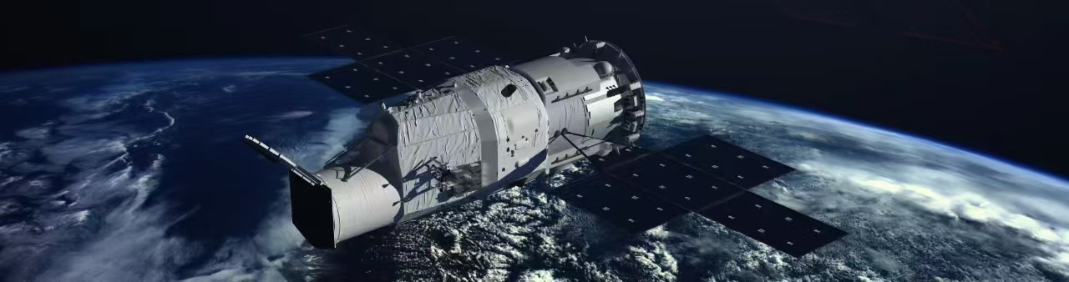
Chinese Space-station Survey Telescope (CSST)
Notes:
2.Along with the blooming of AI, China is rushing on the building of the new flagship space survey telescope, The Chinese Space Station Survey Telescope, or in short the CSST. CSST will produce a few 10 PB imaging and spectral data of billions of galaxies and roughly same order of magnitude stars.

Slide 3
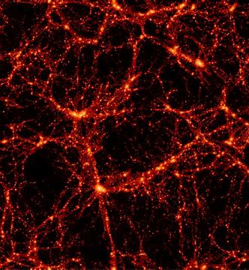
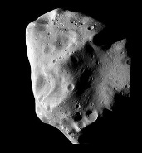
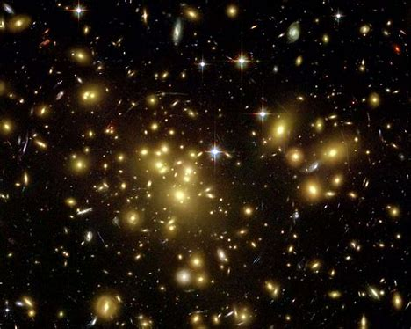
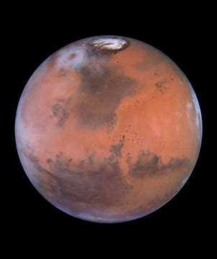
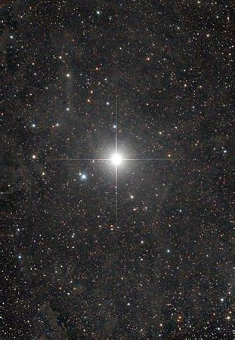
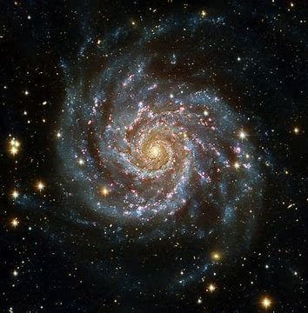
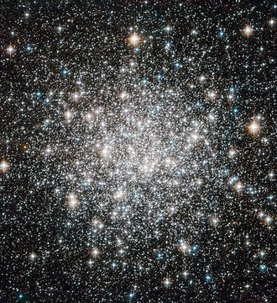
Scientific goals
large structure
& cosmology
nearby galaxies
The Milky Way Solar system objects
Cosmology Astrometry
Stellar physics Exoplanets star formation
Galaxies and AGNs
Transients and variables
asteroids
galaxy clusters
planets
stellar populations
galaxies
stars
Notes:
It will be expected to have breakthroughs not only in cosmology, galaxies, but also a powerful beast for surveying stars and stellar populations in the local universe.

Slide 4
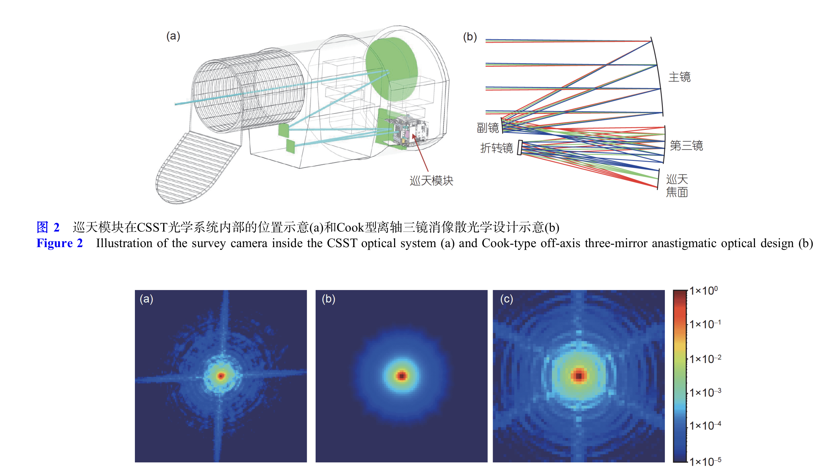
2 meter off-axis three-mirror optical system
Main mirror
Secondary mirror
Folding mirror
Tertiary mirror
Main Survey Camera
Focal plane
Notes:
3.The 2-metre CSST is designed as an unique off-axis optical system, such that the point spread function (PSF) looks very clean in its out-skirts, unlike any other well known space telescopes (e.g. HST and Euclid). This nice feature make it possible to well distinguish stars from extremely crowd fields such as the nearby resolved galaxies.

Slide 5
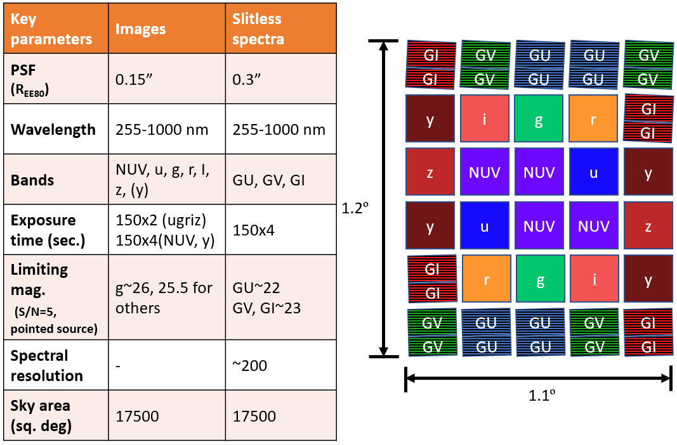
Main Survey
slitless spectrograph
GI
GV
GU
GU
GV
GI
GV
GU
GU
GV
y
i
g
r
GI
GI
9K
z
NUV
NUV
u
y
1.2º
y
u
NUV
NUV
z
multi-band photometry
GI
r
g
i
y
GI
GV
GU
GU
GV
GI
1st order
R~200
GV
GU
GU
GV
GI
1.1º
Notes:
4.Although CSST will be loaded 5 different types of camera, the main survey camera will occupy the major fraction of observation time during it ten-year operation. Here I show you the cartoon of the focal-plain of the main survey camera, which is composed of 30+ CCDs, 18+ of them are for multi-band imaging, while the rest 12 for slitless spectroscopy. Since each CCD has size of 9K by 9K, in total, the focal-plain contains 250 million pixels, making it the second largest astronomical camera, only behind LSST (320 million pixels). This ensures that it has extremely high observational efficiency. I simply list the detailed parameters of the camera in the right-side table.

Slide 6
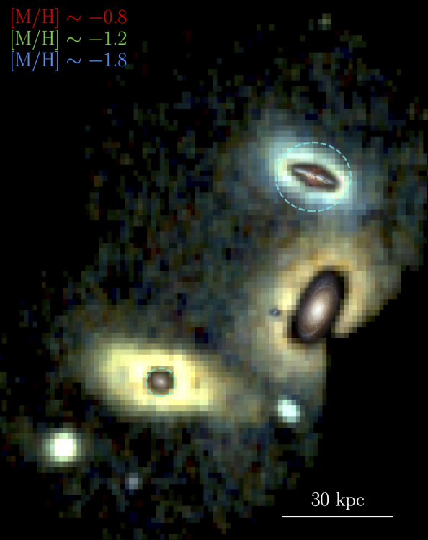

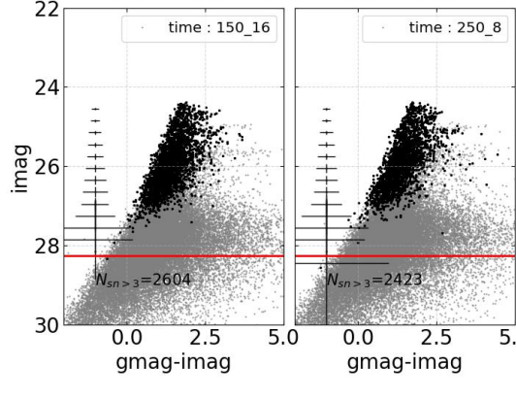
CSST in nearby galaxies study
BSG
RSG
Tip-RGB
OB
BHB
dA
dF
dG
dK
dM
LMC
Virgo
NGC891
t_exp=150s x 16
t_exp=250s x 8
M81
18<g<25
M31
18<r<25
MW virial radius
1kpc
10kpc
100kpc
1Mpc
10Mpc
100Mpc
Notes:
5.Since my scientific interest is in stellar physics and stellar populations, I am specially interested how good that CSST can observe for the nearby resolved galaxies. Simple calculations show that We should observe abundant RGB stars for galaxies with 4 Mpc. For example, if we observe the M81 group, we may take only a week and well cover 9 square degrees sky area, with 8 250 second exposure, or 16x150 second exposure, we are able to reach about two magnitudes deeper than the Tip-RGB stars. This is sufficient for lots of studies of the stars and stellar populations in these nearby galaxies.

Slide 7
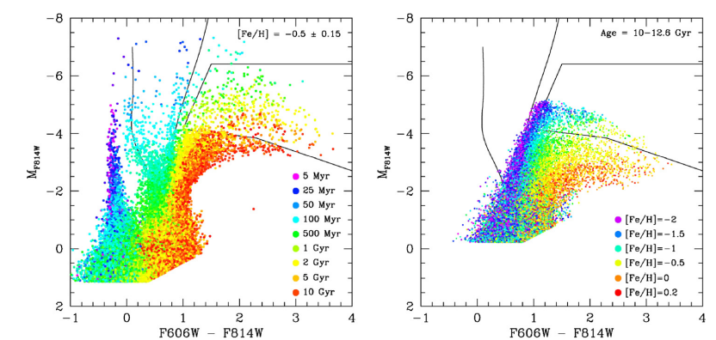
Novel stellar atmospheric model required
Dalcanton+2009
The conventional stellar (atmospheric) models are challenged
  e.g. Massive stars extends to a wide range of the stellar population properties, which are never seen in the solar neighborhood
A new Model should be extended to the cases of chromospheric avtivity, stellar wind/mass ejection, UV radiative field, accretion disk, etc.
Notes:
6.Other than in the Milky Way, in nearby galaxies we will observe stars in populations with wider range of properties, such as age, metallicity, and range of stellar masses. For instance, the massive stars observation in the Milky Way is very limited in mass range and metallicity. However, in the nearby star-forming galaxies, we are able to observe massive stars from 8 to around 100 solar-mass with broad variations of metallicity. One big issue is that, our stellar models, including the structure, evolution, and atmosphere, cannot well match the observations due to the poor performance of the models. Moreover, the new models should be able to model not only normal stars but peculiar objects, which may be found more if our observed samples extend an order of magnitude than before and in a more extended population parameter space, such as UV radiation, stellar wind and ejection, accretion and merging etc. in different metallicities. Therefore, some new stellar models must by developed in advance before we are flooded by the new stellar data from CSST.

Slide 8
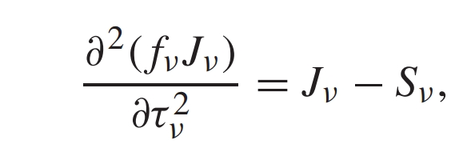

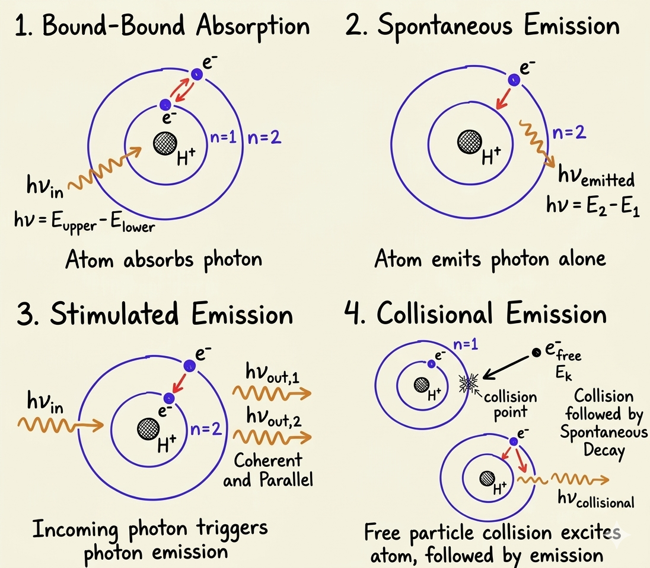
An ab initio stellar atmospheric model
Micro-physical process: A photon, an atom or an electron interact with each other in a micro-volume element (MVE)
  Bound-Bound absorption
  Spontaneous emission
  Ionization (Bound-Free)
  Recombination
  Scatter (Thompson, Rayleigh)
  Bremsstrahlung emission
  Elastic/non-elastic collision
  etc
Monte Carlo simulation
All codes were written by AI, by now 500+M tokens used
Notes:
7.I started from developing a novel stellar atmospheric model. To maximize the generative capability of the model, I abandoned the normal way, that is using macroscopic equilibrium equations, such as radiative transfer equation, Sahe-Boltzmann equation, and statistical equilibrium equation. The conventional atmospheric models always provide a numeric solver for these equations by injecting some strong or weak assumptions, such as LTE or NLTE assumption. These methods are usually quick and easy to be used. However, they have masked a lot of physical mechanisms in microscopic scale. As a result, they are almost impossible to be used in any peculiar stars or very dynamic stellar events.
8.This is a so-called ab initio stellar atmospheric model. The model starts from a Monte Carlo simulation of a micro-volume elements, which is composed of H, He, metal elements with various energy level populations (occupy distribution), and of course free electrons. Photons with certain spectral energy distribution come into the small volume and interact with particles and electrons. The microscopic physical process include the bound-bound absorption, bound-free ionization, spontaneous emission, recombination, free-free collision, scattering (Thompson and Rayleigh), elastic collision, collisional emission etc. All these physical processes are simulated in every very short time interval. Since the number of particles, electrons, and photons are huge, I used macro-particles/electrons, and photon packets to reduce the real number of objects involved in the iteration.

Slide 9
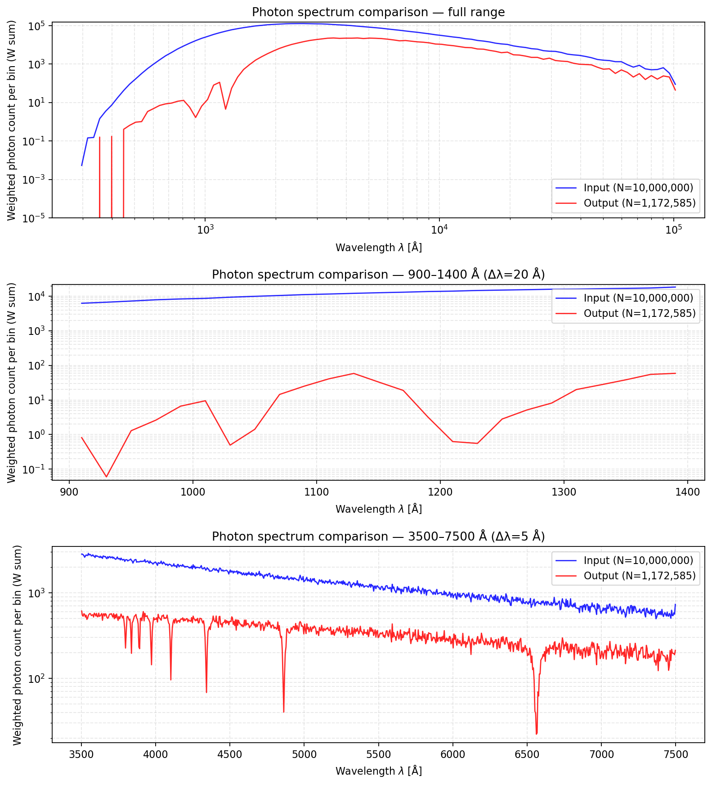
Test One---dense mass radiative process
Lyman absorptions
Balmer absorptions
Notes:
9.Here is the simple test result for a very sense small volume element exposed under the black body radiation with T=20000. After a while, the light runs through the small dense mass show clear absorption of Balmer lines. And this shows that the radiative transfer process can by simulated in micro-physical processes.

Slide 10
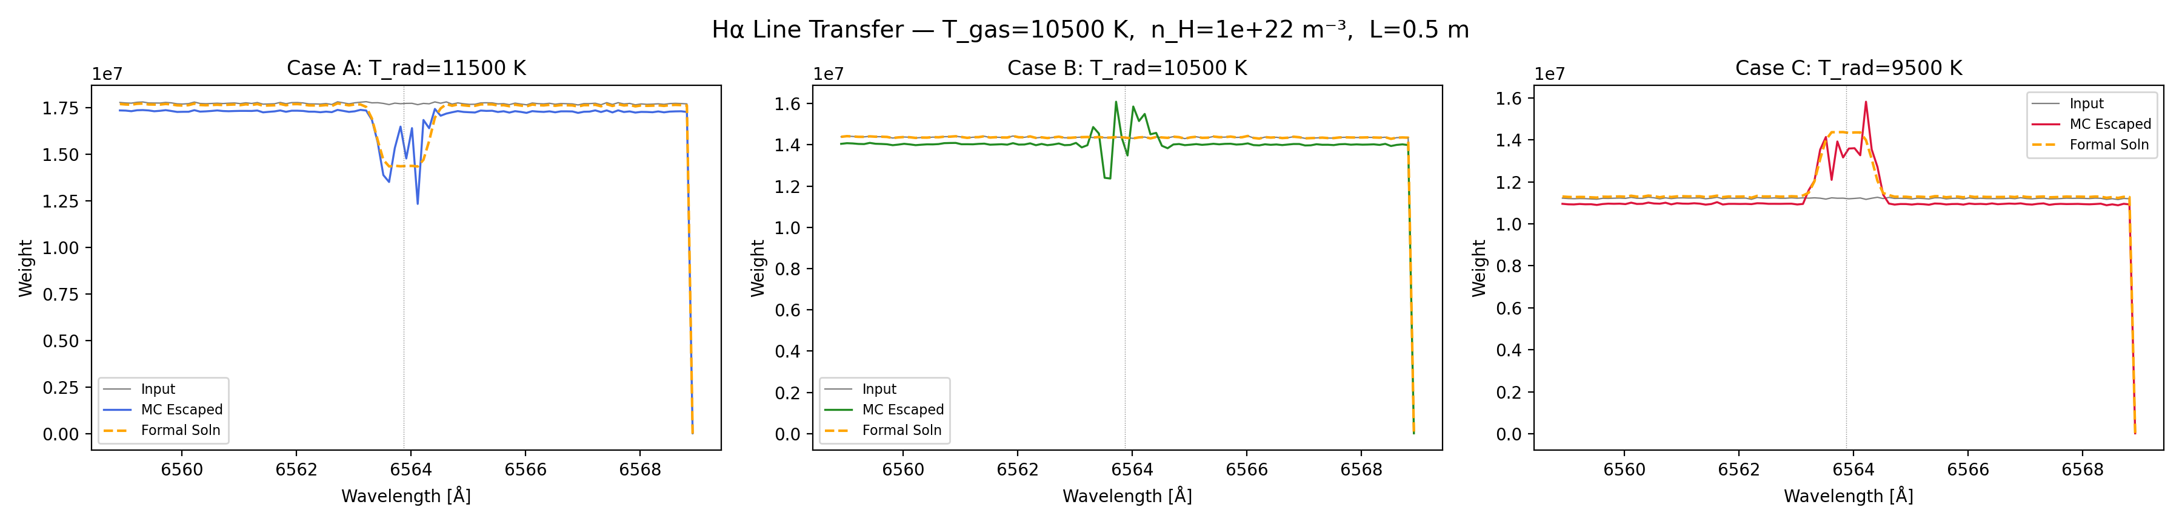
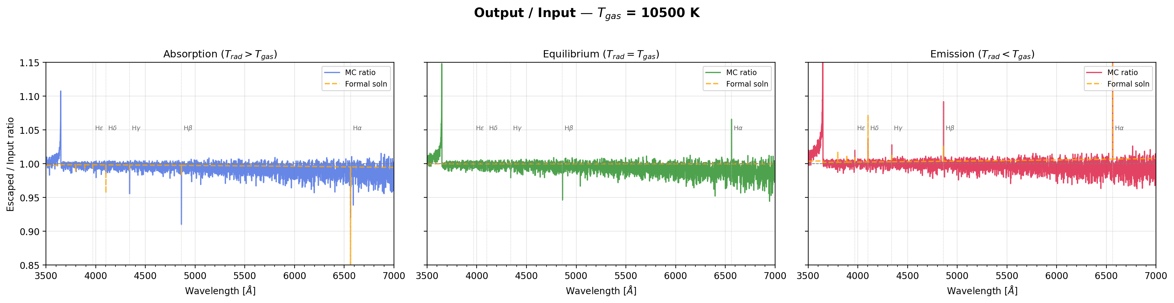
Test two---LTE validation
Kirchhoff’s laws
Notes:
10.And this test shows that if I set the initial parameters obeying the LTE state, With radiative temperature larger than, equal to and less than the particle kinetic temperature, we should find absorption, no line, and emission line and 6563 Angstrom, which is the H-alpha line. The dashed lines give the analytical calculation based on LTE equations, and the colored solid lines show the results coming out of the testing microscopic Monte Carlo simulation. It shows that without any constraint, the simulations automatically satisfy the LTE state given the proper initial conditions.

Slide 11
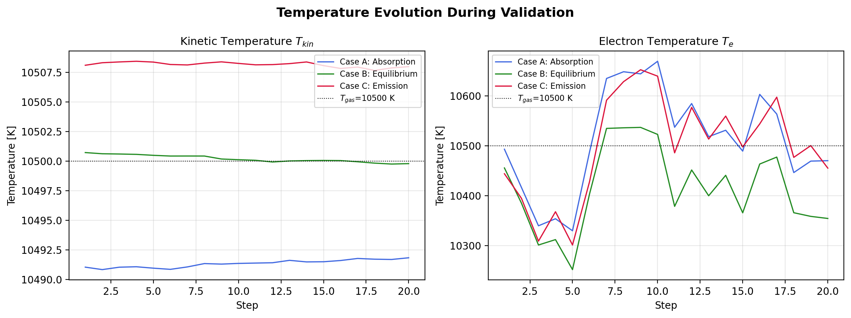
Test two---LTE validation

Slide 12
Future plan
Deep learning algorithm to accelarate the reject samplings
Generative AI to predict SEDs from given MVE
MVEs as bricks to set up a stellar atmosphere or anything you like
Combined with fluid dynamics
Notes:
11.The next stage will be: first this simulation is very slow currently, so it should be modified by replacing the direct reject sampling by neural networks, such as Normalizing flow with selected physical constraints in its loss function. Second, Thousands of the micro volume element simulations with different initial and final configurations should be calculated and inject into a generative deep learning framework (diffusion model, for instance) as training dataset. Then by using this generative AI as bricks, we are able to set up a complete stellar atmospheric model. There are still a bunch of work need to be done, such as let the particles in the volume flow through into the neighboring volume so that the model can deal with the fluid dynamics in the radiative transfer process, which is the real situation inside the stars.

Slide 13
Thinkings
What does AI+Astronomy should be like?
  Two types of AI applications
    Algorithm
    Agents
Both are essentially combinatorial optimization solvers
  Finite and fixed solution spaces and clearly defined optimatization functions
However, discoveries do not always rely on combinatorial optimization
  dynamical/infinite solution space or no optimatization functions
  Astronomers (human), therefore, play irreplacable role: i.e. originality, perfessional judgement ability, and taste (intuition)
Notes:
12.I have to claim that the whole work starting from the end of January was done by AI-assisted coding. I did not write a single row of python, but wrote lots of prompts. By now, I have consumed more than 5 hundreds million tokens for this work. At this point, we can think deeper to unveil two types of application of AI: type one---algorithms to calculate physical process in a efficient way; and type two---personal assistant (Agents) to do hard but predictive work for an astronomer. No matter which type, essentially, AI can work because all these work can be finally mapped to a combinatorial optimization problem, which space of solution is fixed (static) and finite. Meanwhile, one can always find a proper optimazation function for the problem. Then what AI does is to search and find the solution that minimize the optimzation function. Reinforcement learning can accelerate the searching procedure, while LLMs usually depend on the power of the hardware (expensive). Astronomers, on the other hand, should focus on the originality, judgment, and taste (intuition).

Slide 14
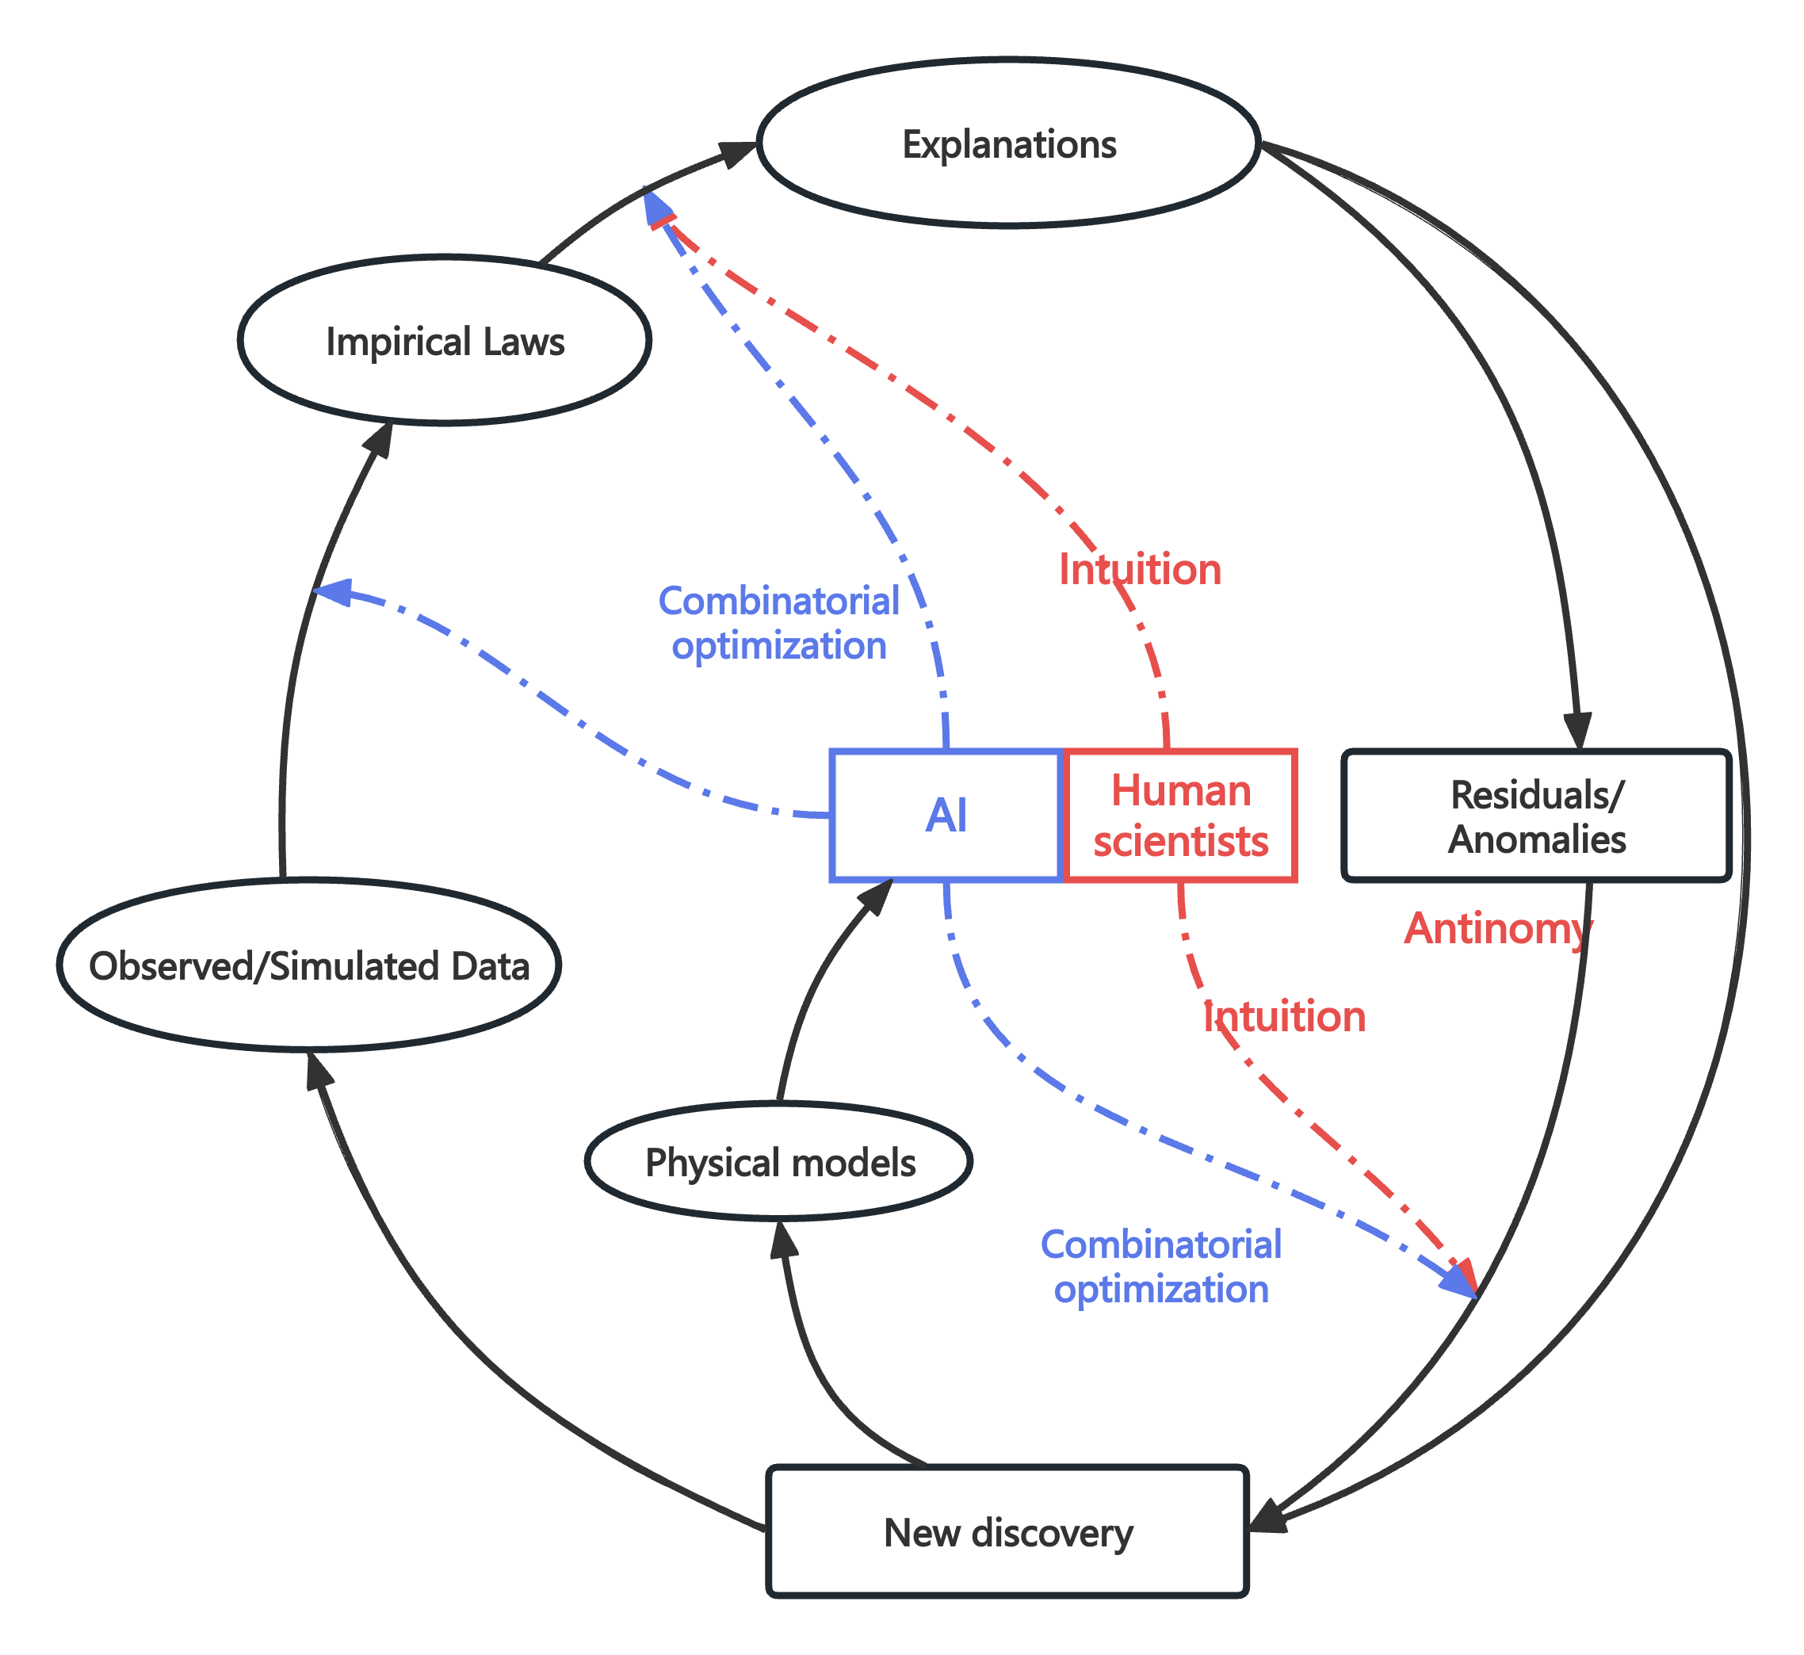
AI+Astronomy paradigm
combinatorial optimization problems
VS.
Non-combinatorial optimization problems：
Originality, Judgment, and Taste (Intuition)

Slide 15
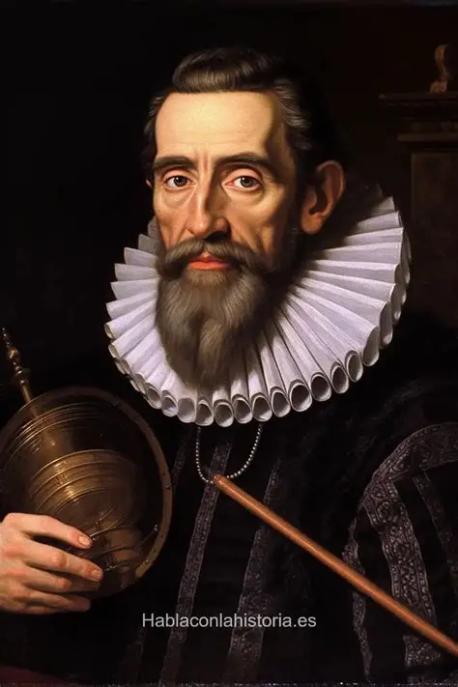
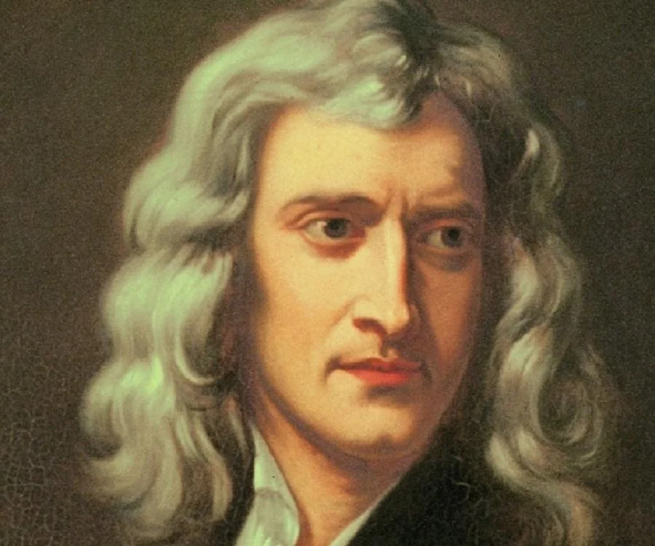
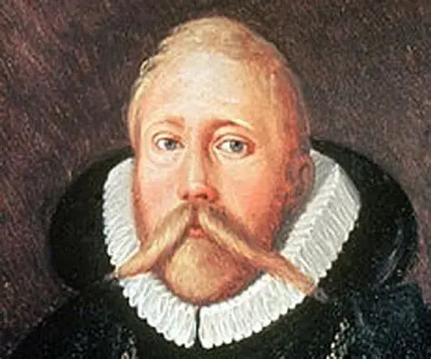
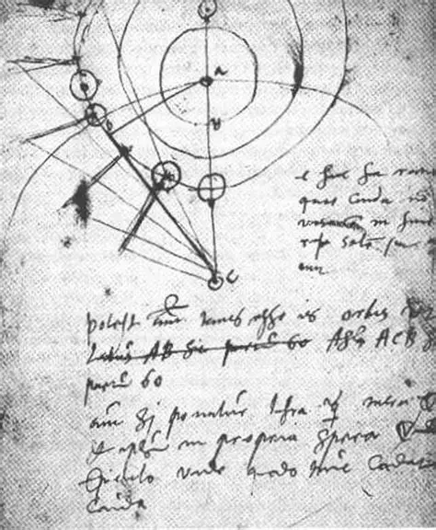
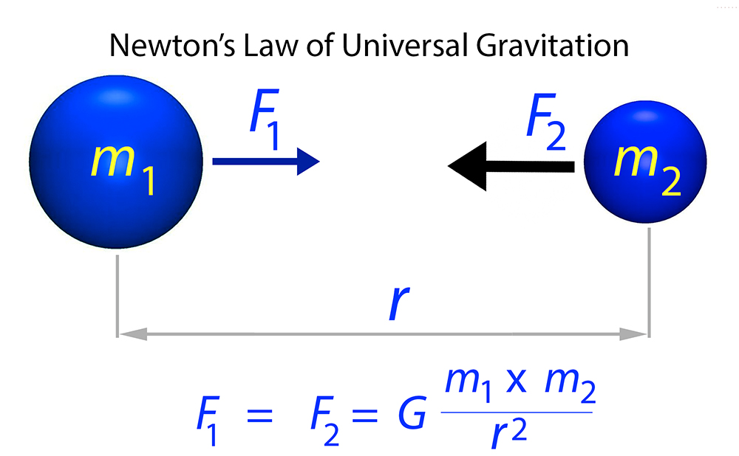
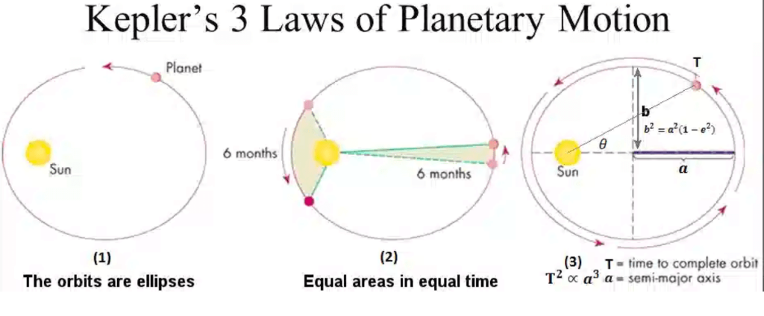
Summary
This needs professional knowledge, deep understanding of the nature of the physical world, and intuition of the direction, which would not be replaced by AI.
AI will be able to take the place of Kepler
but will NOT be able to take the place of Newton
Notes:
14.Lets finally see the example as my summary of the talk. Tycho Brahe collected data. This can be assisted by AI, Johannes Kepler find the three Kepler’s laws by recombining the observed data of planets and finding some internal connection between the data. This will be ruthlessly replaced by AI. Newton induced the concept of gravity and discovered the law of gravity to explain the motion laws of planet. This would not be replaced by AI, and this will be the unique characteristcs of a scientist in the AI era. We should leave the discoveries of data-driven empirical laws to AI or with the assistance of AI. Human scientists should judge the result coming out of AI and find which one is more important. This needs professional knowledge, deep understanding of the nature of physical world and intuition of the direction.

