Slide 1
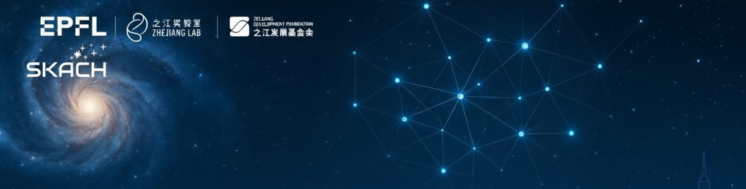

AI + Astronomy: Models, Data, Discovery
PI-AstroDeconv: Physics-Informed Deep Learning for Telescope Beam Deconvolution
Shulei Ni·Zhejiang Lab
2026.03.31·EPFL

Slide 2
Content
Background and Motivation
  HI Intensity Mapping
  HI Observation Pipeline
Deep Learning for Foreground Removal
  Datasets Simulation
  Unet-3D Architecture
PI-AstroDeconv Framework
  SDC3a Datasets
  PI-AstroDeconv Architecture
Other Applications
  JWST
  Network Extension
Conclusions

Slide 3
Content
Background and Motivation
  HI Intensity Mapping
  HI Observation Pipeline
Deep Learning for Foreground Removal
  Datasets Simulation
  Unet-3D Architecture
PI-AstroDeconv Framework
  SDC3a Datasets
  PI-AstroDeconv Architecture
Other Applications
  JWST
  Network Extension
Conclusions

Slide 4
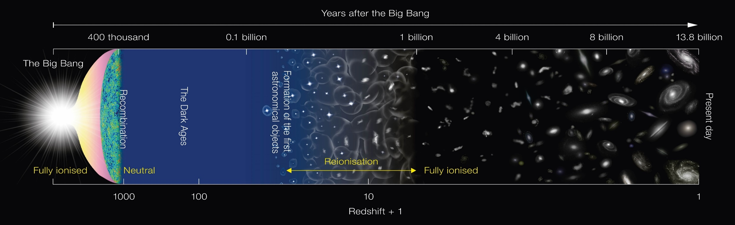
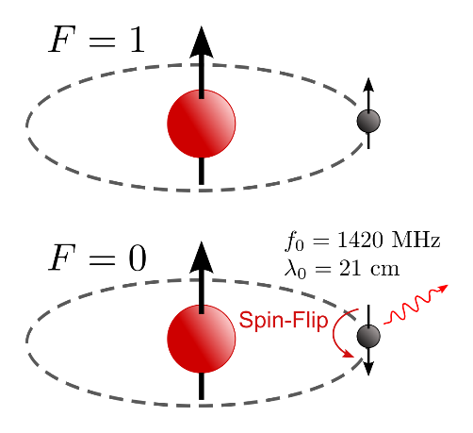
1.1 HI Intensity Mapping
Epoch of Universe:
  Cosmic Dark Ages (30 < z < 1100, 0.38-101 MY)
  Cosmic Dawn (15 < z < 30, 101-272 MY)
  Epoch of Reionization (6 < z < 15, 272 – 941 MY)
Hyperfine Structure：
emit

Slide 5

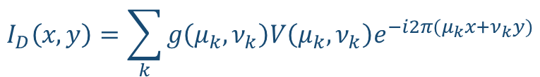




1.2 HI Observation Pipeline
Interferometer diagram:
Visibility(V):
FFT:
Gridded Visibility Function and DFT, Dirty Image:
FFT $⇋$ Convolution :
$I′$ is real image, $P_{D}$ is the dirty beam (PSF):
$$V\left(μ,ν\right)=\int_{−∞}^{∞}{\int_{−∞}^{∞}{A\left(x, y\right)I\left(x, y\right)e^{i2π(μx+νy)}dxdy}}$$
$$I^{′}\left(x,y\right)=A\left(x, y\right)I\left(x, y\right)=\int_{−∞}^{∞}{V\left(μ,ν\right)e^{−i2π(μx+νy)}dμdν}$$
$$I_{D}\left(x, y\right)=\sum_{k}{g\left(μ_{k}, ν_{k}\right)V\left(μ_{k},ν_{k}\right)e^{−i2π(μ_{k}x+ν_{k}y)}}$$
$$I_{D}\left(x, y\right)=P_{D}\left(x, y\right)⨂I′(x, y)$$

Slide 6

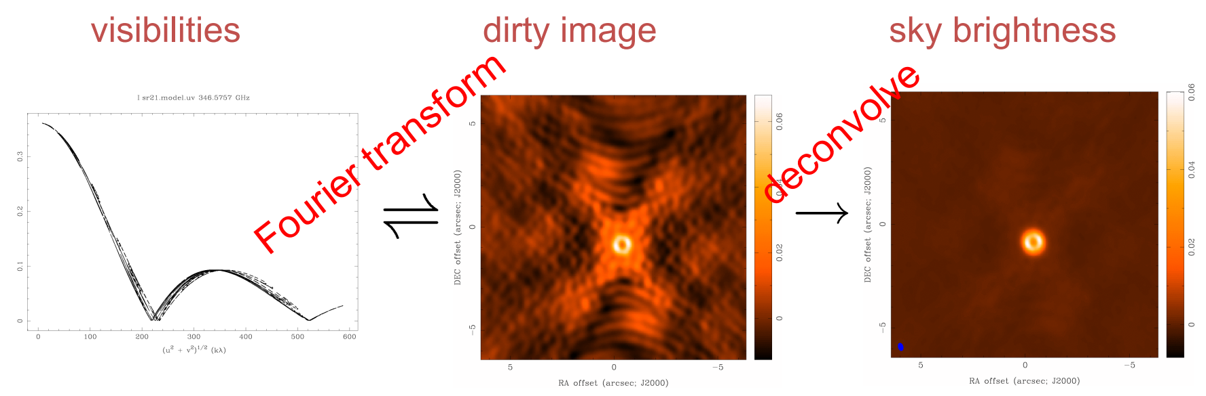
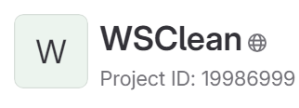
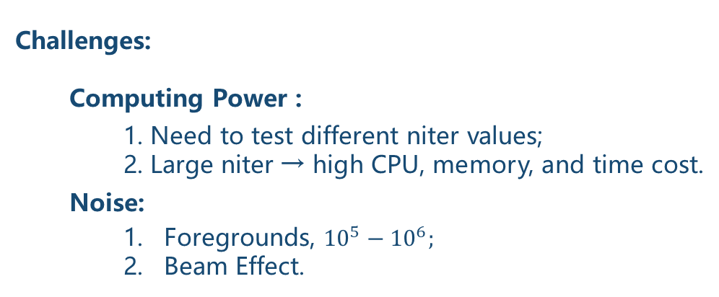
1.2 HI Observation Pipeline
Formula(traditional)：
tclean(vis=‘xx.ms’, imagename=‘SNR.MultiScale’, deconvolver=‘multiscale’, scales=[0,6,10,30,60], smallscalebias=0.9, imsize=4095, cell=‘16arcsec', pblimit=-0.01, niter=1000,weighting='briggs', stokes=‘I’, robust=0.0, interactive=False, threshold='0.12mJy', savemodel='modelcolumn')
  Challenges:
  Computing Power :
    1. Need to test different niter values;
    2. Large niter → high CPU, memory, and time cost.
  Noise:
    Foregrounds, ${10}^{5}−{10}^{6};$
    Beam Effect.
$$V(μ, ν)\underset{→}{\text{FFT}}Dirty Image=Dirty Beam ⨂ Real Image$$
$$Clean Image=Clean Beam ⨂ Model$$
wsclean -reorder -use-wgridder -parallel-gridding 10 -weight natural -oversampling 4095 -kernel-size 15 -nwlayers 1000 -grid-mode kb -taper-edge 100 -padding 2 -name out_name -size 2048 2048 -scale 16asec -niter 0 -pol xx -make-psf in_ms
Deep Learning?

Slide 7
Content
Background and Motivation
  HI Intensity Mapping
  HI Observation Pipeline
Deep Learning for Foreground Removal
  Datasets Simulation
  Unet-3D Architecture
PI-AstroDeconv Framework
  SDC3a Datasets
  PI-AstroDeconv Architecture
Other Applications
  JWST
  Network Extension
Conclusions

Slide 8
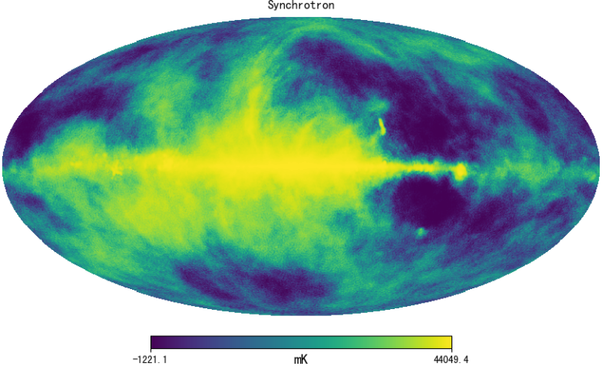
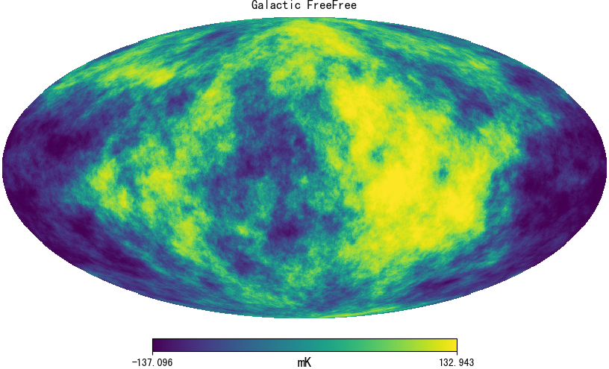
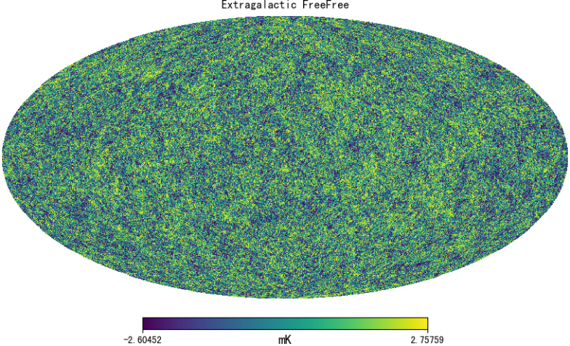
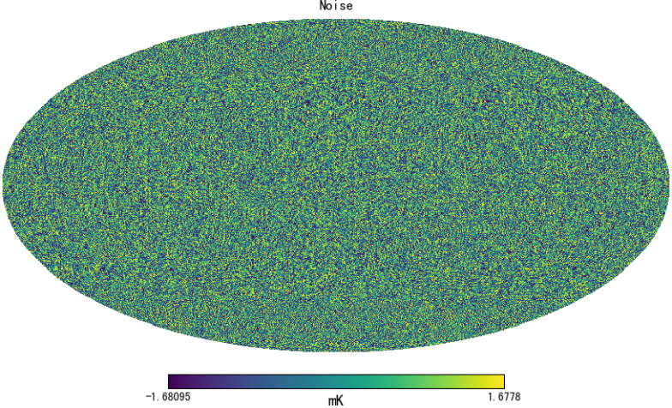
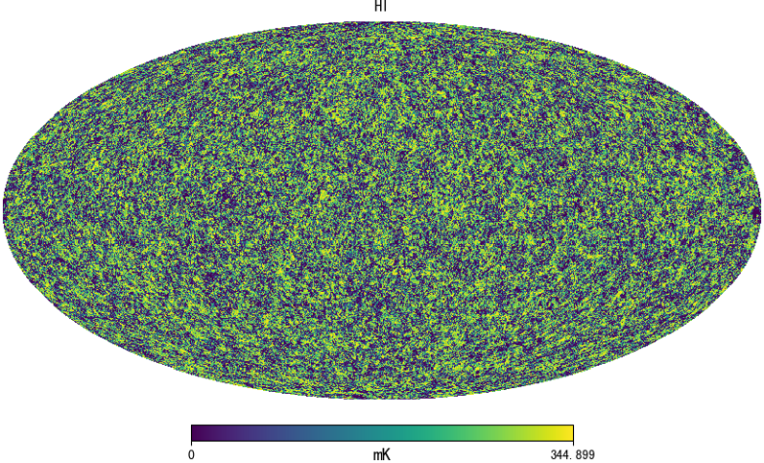

2.1 Datasets
DATA: simulate with CRIME
+
+
+
+

Slide 9
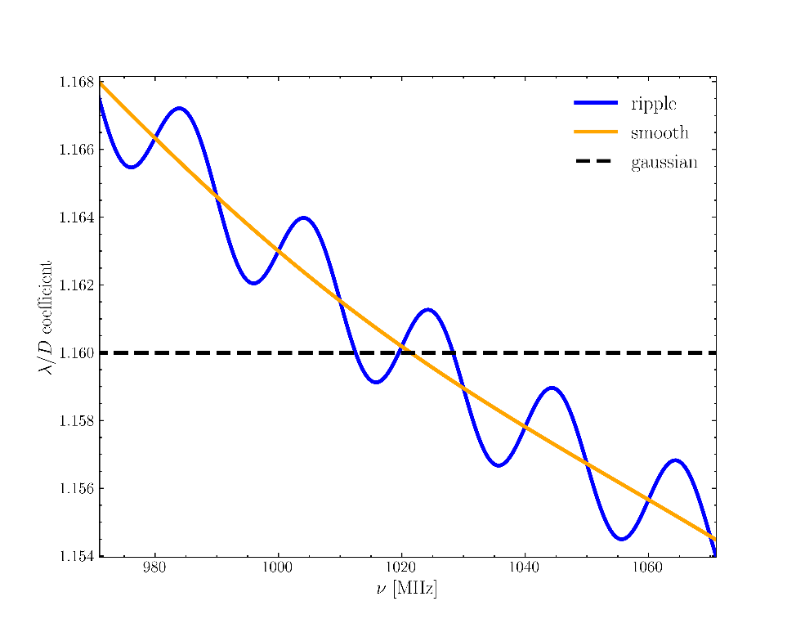
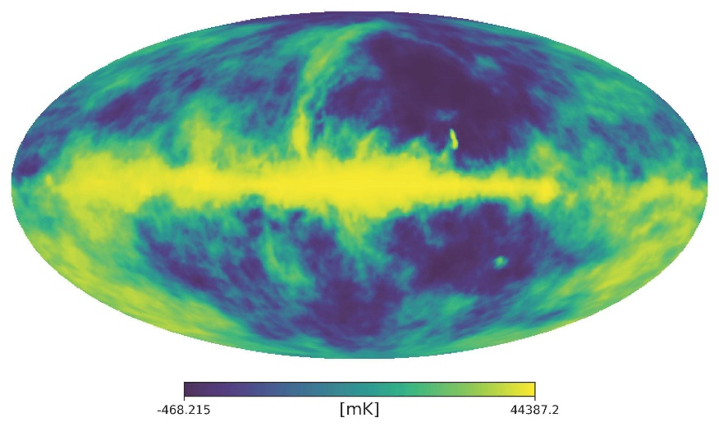
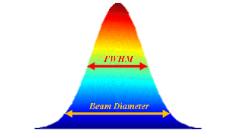
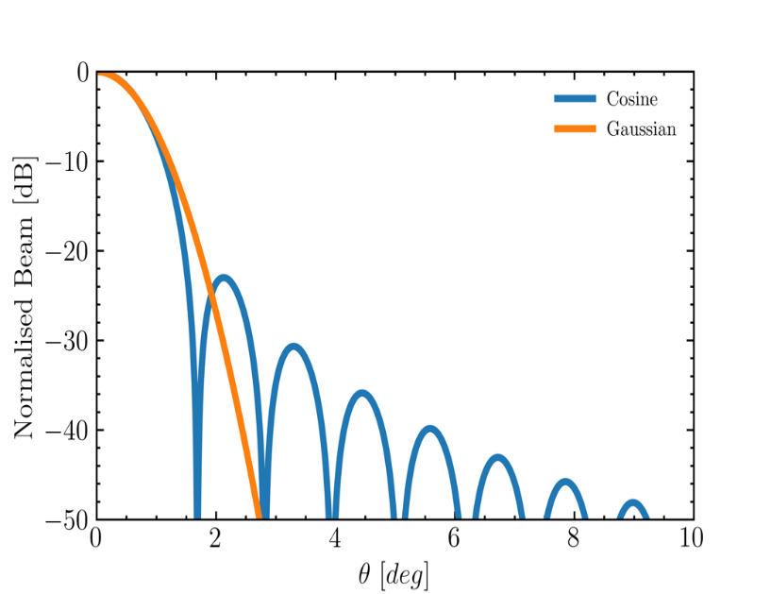

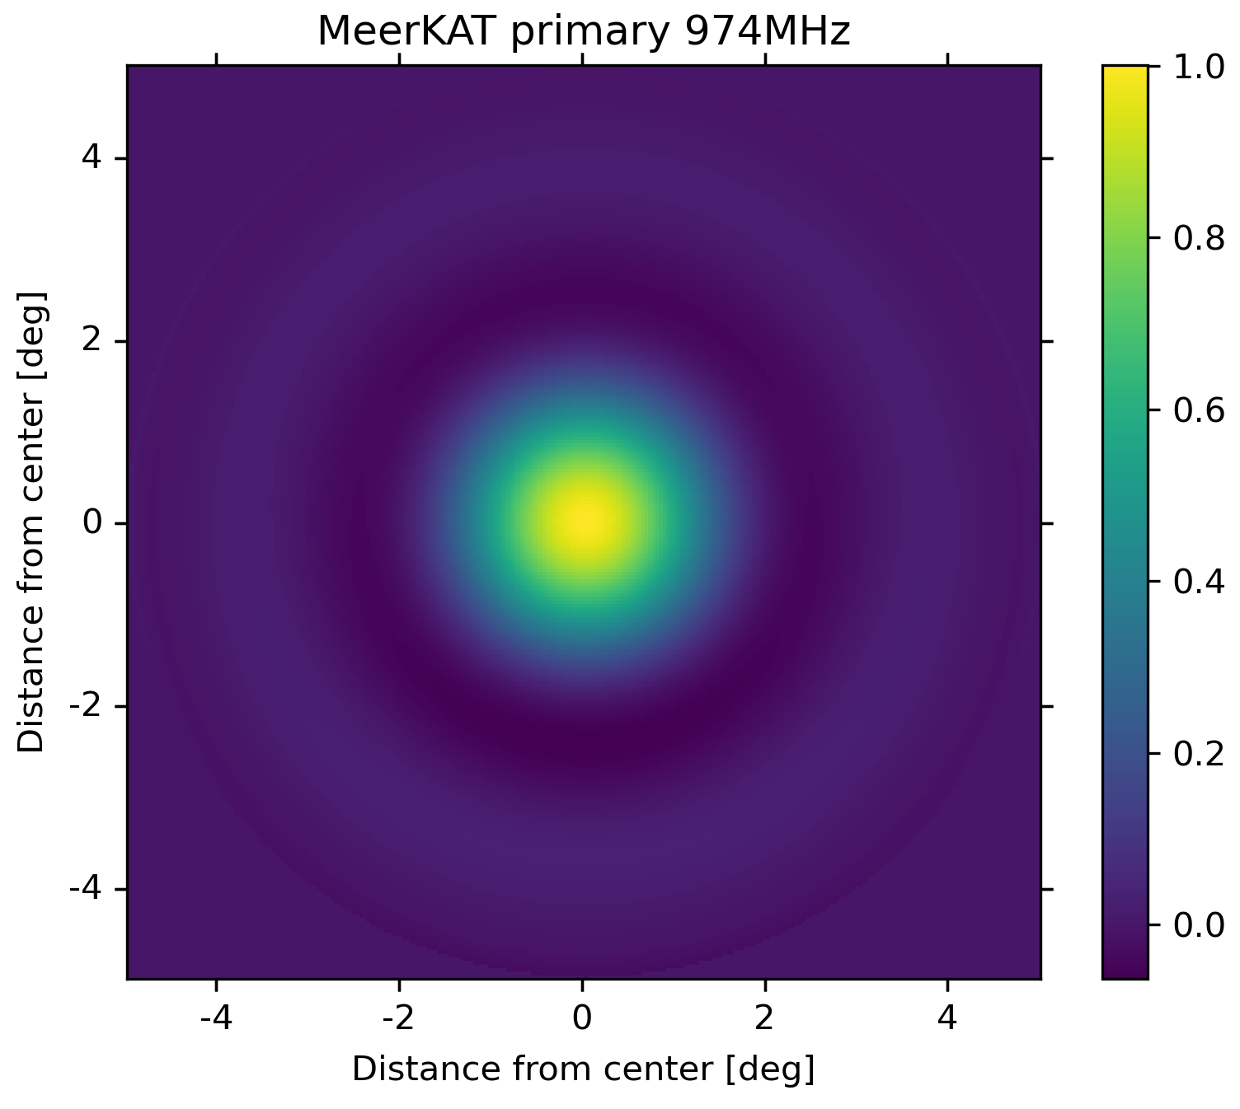

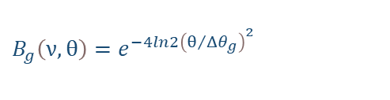
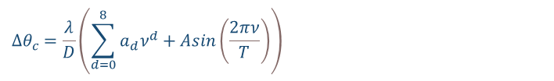
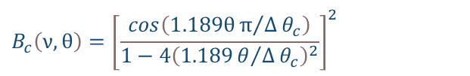
2.1 Datasets
Beam: simulation
Gaussian Beam：
$$B_{g}\left(ν,θ\right)=e^{−4ln2{\left(θ/Δθ_{g}\right)}^{2}}$$
$$Δθ_{g}=1.16\frac{λ}{D}$$
MeerKAT Beam：
$$B_{c}\left(ν,θ\right)={\left[\frac{cos\left(1.189θπ/Δθ_{c}\right)}{1−4{\left(1.189θ/Δθ_{c}\right)}^{2}}\right]}^{2}$$
FWHM vs Freq
Gaussian Beam Smoothing
$$Δθ_{c}=\frac{λ}{D}\left(\sum_{d=0}^{8}{a_{d}ν^{d}}+Asin\left(\frac{2πν}{T}\right)\right)$$
Beam Power
Cosine Beam Smoothing

Slide 10

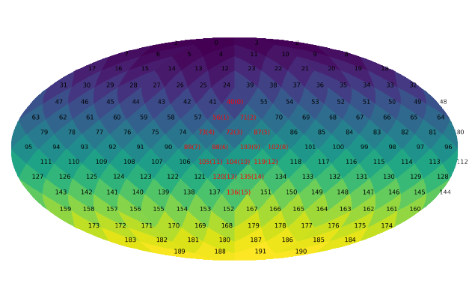
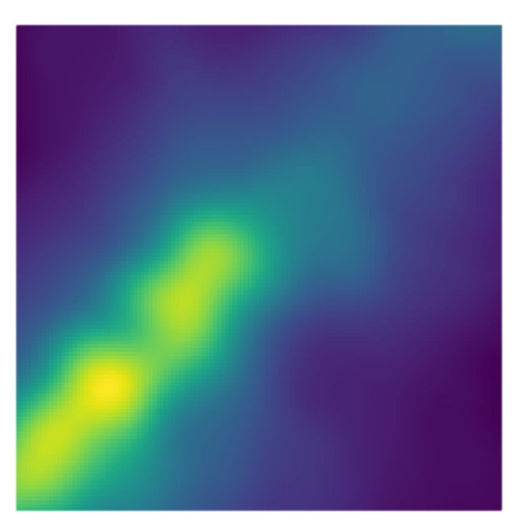
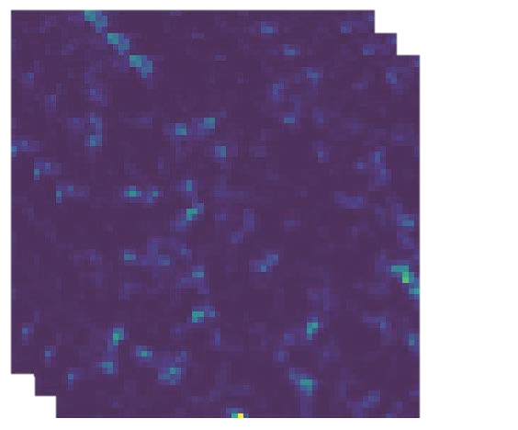
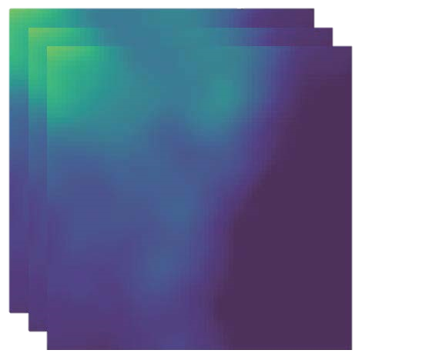
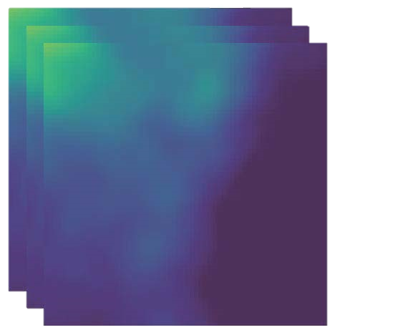
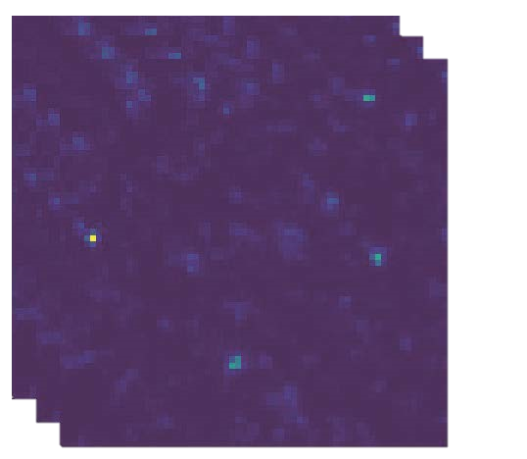
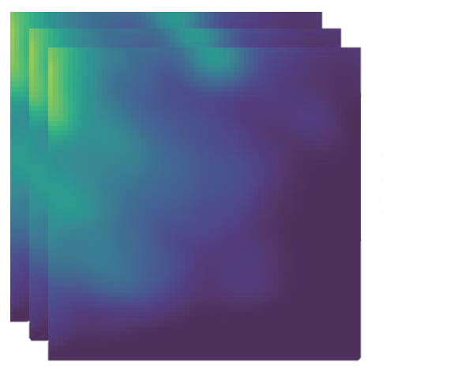

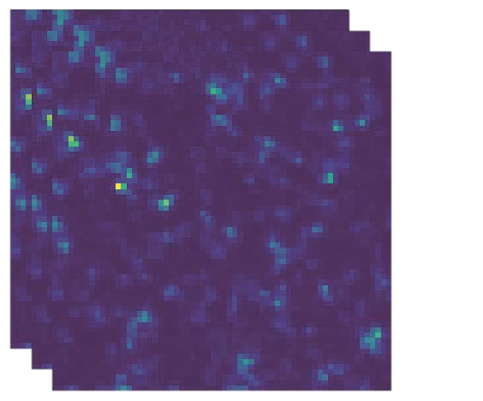
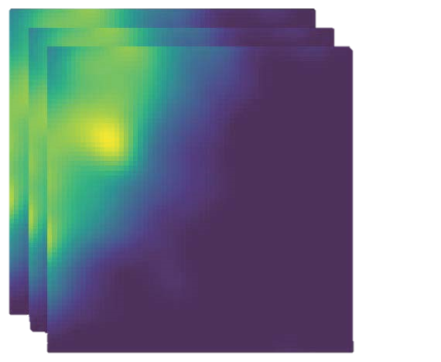

2.1 Datasets
Nside=1:
Nside=4(based map):
Nside=256(one patch):
Upgrade
1→4
Upgrade
4→256
64
12 pixels
64
192 pixels
192*(64*64) pixels
Datasests:
Label(HI)
Gaussian Smoothing(HI+FG)
Cosine Smoothing(HI+FG)

Slide 11
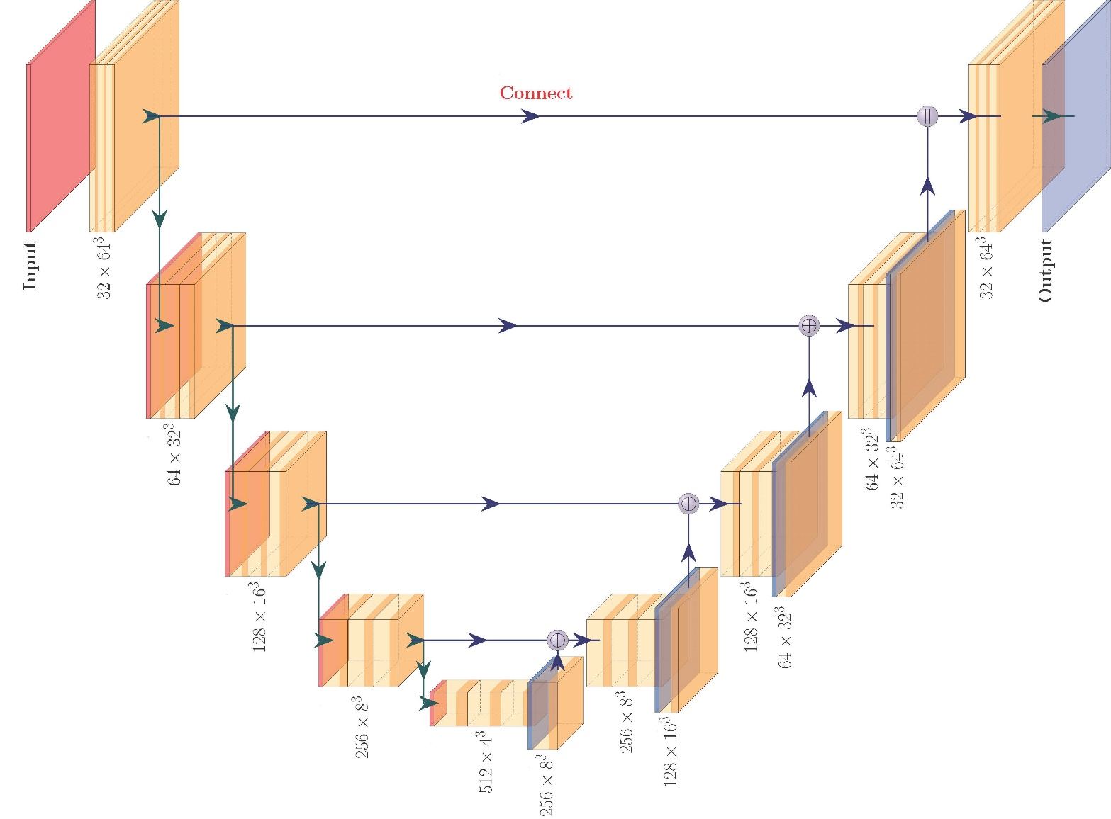
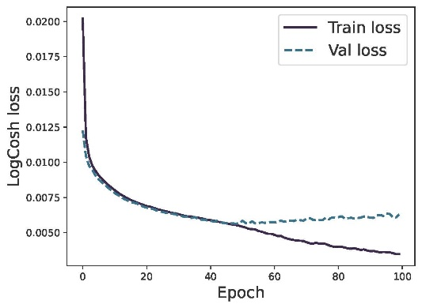
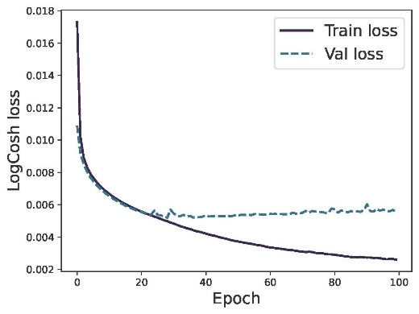
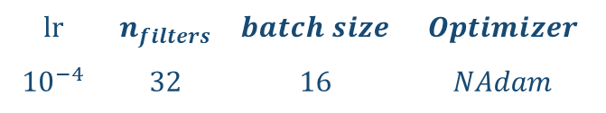
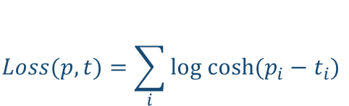
2.2 Unet-3D
Unet-3D Architecture:
Loss Function:
$$Loss(p, t)=\sum_{i}{log cosh(p_{i}−t_{i})}$$
Hyperparameters:
$$lr$$ | $$n_{filters}$$ | $$batch size$$ | $$Optimizer$$
$${10}^{−4}$$ | $$32$$ | $$16$$ | $$NAdam$$
Loss vs Epoch:
Gaussian Beam
Cosine Beam

Slide 12
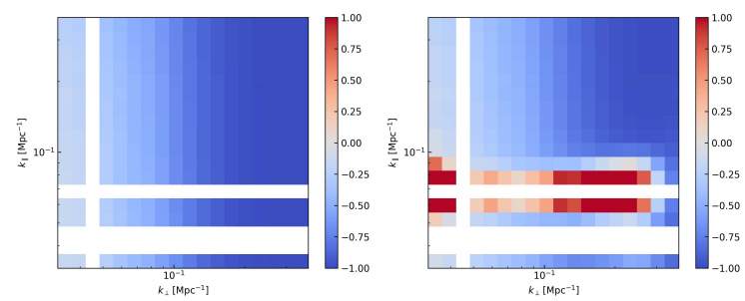
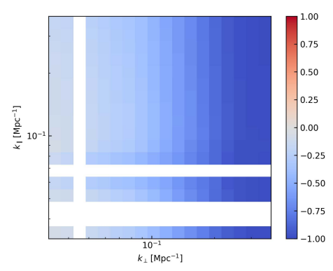
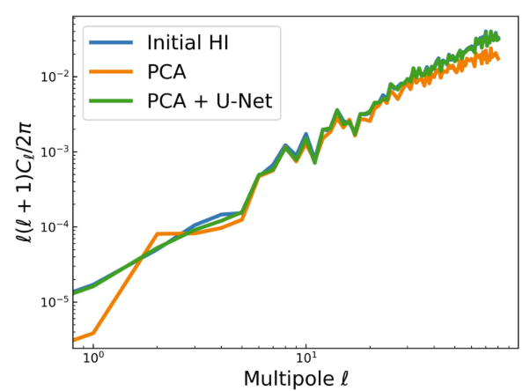
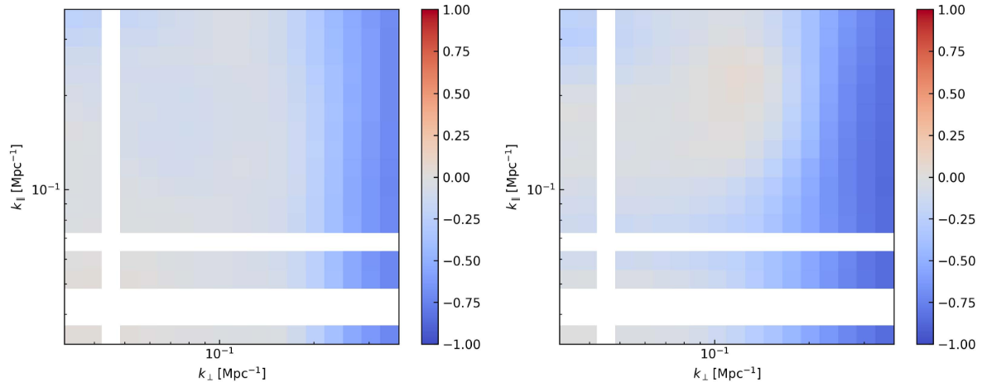
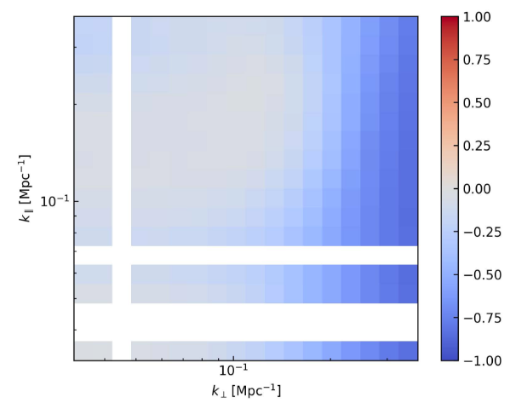
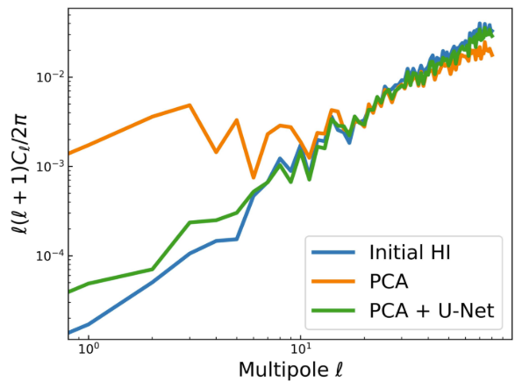
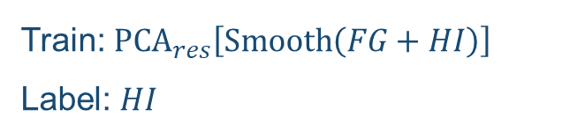
2.2 Unet-3D
Train: $PCA_{res}\left[Smooth\left(FG+HI\right)\right]$
Label: $HI$
2D auto-correlation power spectrum：
PCA cleaned map (Gaussian Beam) PCA cleaned map (Cosine Beam) U-Net cleaned map (Cosine Beam)
Angular Power Spectrum：
Gaussian
2D cross-correlation power spectrum：
PCA cleaned map (Gaussian Beam) PCA cleaned map (Cosine Beam) U-Net cleaned map (Cosine Beam)
Cosine
Supervised Model
APJ 934.1 (2022): 83

Slide 13
Content
Background and Motivation
  HI Intensity Mapping
  HI Observation Pipeline
Deep Learning for Foreground Removal
  Datasets Simulation
  Unet-3D Architecture
PI-AstroDeconv Framework
  SDC3a Datasets
  PI-AstroDeconv Architecture
Other Applications
  JWST
  Network Extension
Conclusions

Slide 14
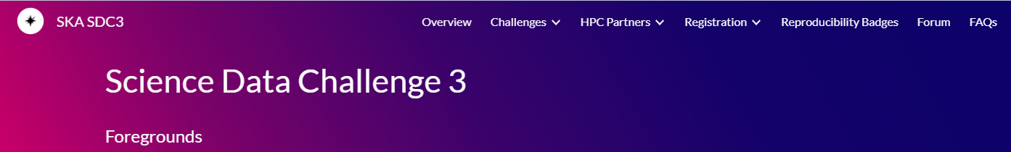
3.1 SDC3a
SDC3a:
  Objective: Detect the faint Hydrogen-21cm signal from the Epoch of Reionisation (EoR). Datasets(image and visibility):
  1. Volume: 7.5TB
  2. Freq: 106-196(z=[6, 15])
  3. Resolution: 16x16 arcsec, 100kHz
  4. Pixels Number(RA/Dec): 2048x2048; (cube: 900x2048x2048)
  5. Synthesised Beam and Thermal noise
  Task: Perform Foreground Removal to isolate the EoR signal from the noisy data.

Slide 15
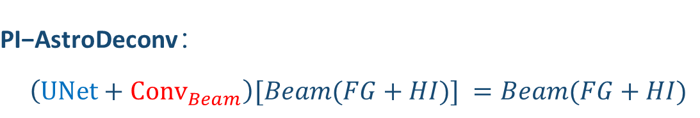
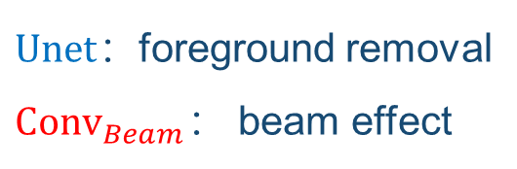

3.2 PI-AstroDeconv
Results of Foreground Removal (based on the Unet-3D job):
Success （√） : simple beam model (gaussian beam), PCA can remove the foreground;
Failure （×） : complex beam model (MeerKAT beam, cosine beam), PCA can not work.
Formula (PCA, Smooth Beam, U-Net as an operator):
$$UNet\{{PCA}_{res}\left[{Smooth}_{beam} \left(FG+HI\right)\right]\}≈HI$$
$${PCA}_{res}\{UNet\left[{Smooth}_{beam} \left(FG+HI\right)\right]\}≈HI$$
$$\text{PI}\text{−}\text{AstroDeconv}：$$
$\left(UNet+{Conv}_{Beam}\right)[Beam(FG+HI)] =Beam(FG+HI)$
Networks
PSF
Dataset
Dataset
$Unet$：foreground removal
${Conv}_{Beam}：$ beam effect
Prediction
Dataset$：Train= Label :Beam(FG+HI)$

Slide 16
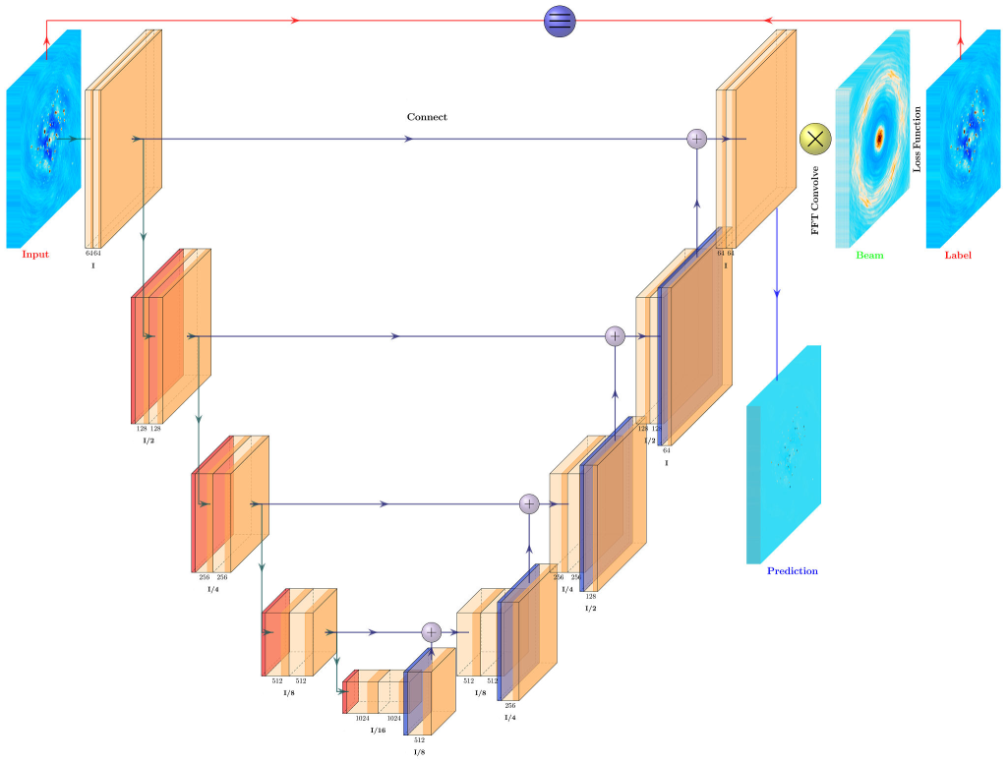
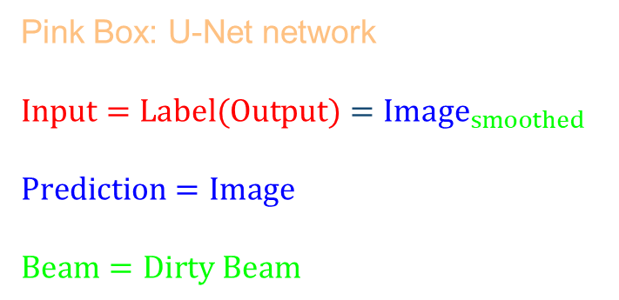
3.2 PI-AstroDeconv
PI-AstroDeconv Architecture :
Pink Box: U-Net network
$$Input=Label(Output)={Image}_{smoothed}$$
$$Prediction=Image$$
$$Beam=Dirty Beam$$
LogCosh
$$Dirty Image=Dirty Beam ⨂ Real Image$$

Slide 17
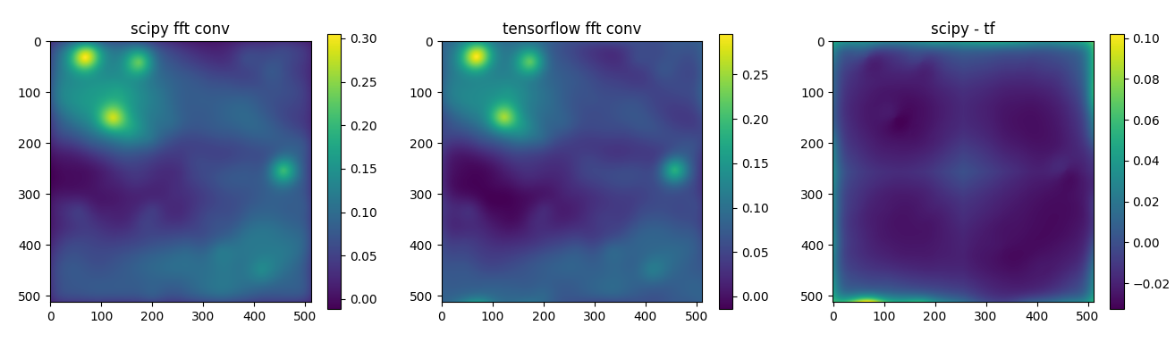
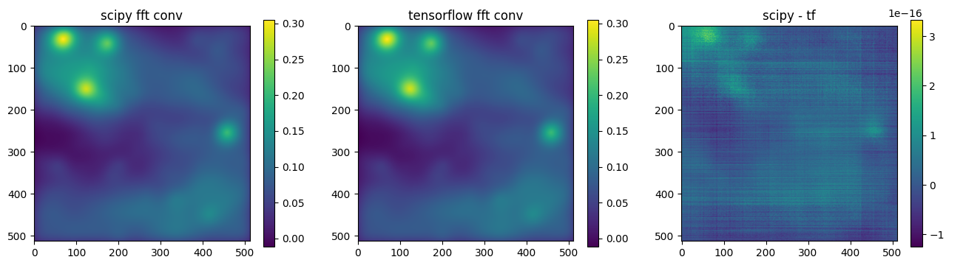

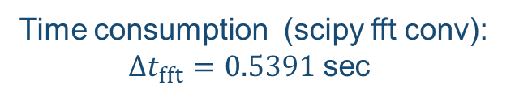



3.2 PI-AstroDeconv
SDC3a：
  Inputs: Large size, (2048*2048)
  Beam : Large size, (2048*2048)
×
FFT Convolution :
Standard Convolution(w=h=n):
$$O\left(n×n\right)=O(n^{2})$$
Time consumption (scipy conv):
$Δt_{conv}=37797.2303$ sec
√
FFT Convolution(w=h=n):
$$O\left(n×n\right)=O[n×\log\left(n\right)]$$
Time consumption (scipy fft conv):
$Δt_{fft}=0.5391$ sec
$$\frac{Δt_{conv}}{Δt_{fft}}=70111.7238$$

Slide 18





3.2 PI-AstroDeconv
SDC3a Dataset:
Slice : Freq = 171.7MHz
SDC3a Results
Freq band: 166MHz – 181MHz
Clean Image
PSF
Dirty Image
$$R\left(k_{∥}, k_{⊥}\right)=|\frac{P_{pred}\left(k_{∥}, k_{⊥}\right)}{P_{truth}\left(k_{∥}, k_{⊥}\right)}−1|$$
SDC3a：
Top 3% (9/324, score) and 1% (3/324, chi-square) in SKA Data Challenge 3a (SDC3a, Mar–Oct 2023), among 324 global teams (77 from China).
$$Γ=Mean\{R{\left(k_{∥}, k_{⊥}\right)}_{X}\}$$
MN, 2025, 543(2): 1092-1119; APJ, 2025, 990(2): 122

Slide 19
Content
Background and Motivation
  HI Intensity Mapping
  HI Observation Pipeline
Deep Learning for Foreground Removal
  Datasets Simulation
  Unet-3D Architecture
PI-AstroDeconv Framework
  SDC3a Datasets
  PI-AstroDeconv Architecture
Other Applications
  JWST
  Network Extension
Conclusions

Slide 20





4.1 JWST
JWST Datasets
NIRCam | SW (Short Wavelength) | 0.6–2.3 µm
 | Filters | F070W, F090W, F115W, F150W, F200W
 | LW (Long Wavelength) | 2.4–5.0 µm
 | Filters | F277W、F356W、F444W
NIRISS | Wavelength | 0.6–5.0 µm
 | Broadband Filters | F090W, F115W, F150W, F200W, F277W, F356W, F444W
 | Medium-band filters | F140M, F158M, F380M, F430M, F480M
JWST PSF:

Slide 21



4.1 JWST
WEBB Test Datasets:
Results(SSIM&PSNR):
Results(Image):
arXiv:2403.01692

Slide 22




4.2 Network Extension
Different Networks:
Different Beams:
Replaceable with any regression model.
Works with partial telescope beams:
EHT, ALMA (CCNU), SDSS(Paris Obsorvatory),
VLA, HST…

Slide 23
5. Conclusions
Build Unet-3D, for foreground removal
Built PI-AstroDeconv, a smart tool that mixes physics informations with AI to clean telescope images.
It succeeds not just for radio telescopes (SKA) but also for other telescopes like JWST.
Thanks！

