Slide 1
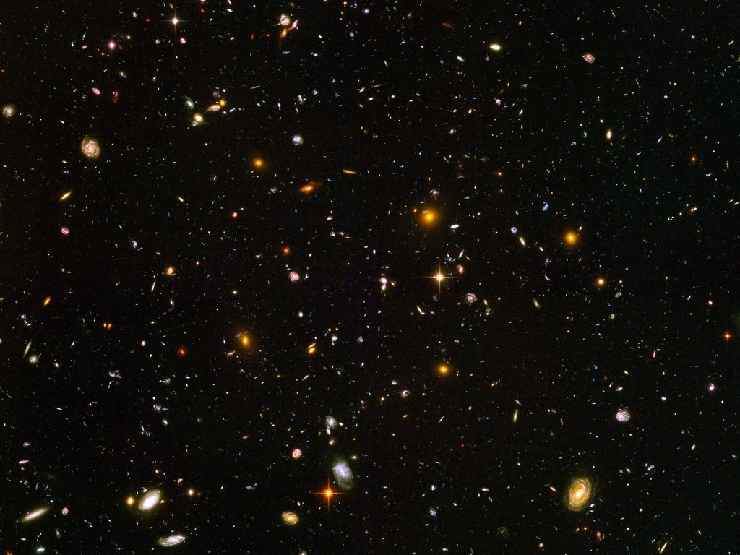
EPFL
01.04.2026
Increasing the Precision of Surrogate Models for
Weak Lensing Mass Maps with Flow Matching
Author: Guangjian Li, University of Zurich
Prof. Tomasz Kacprzak, FHNW

Slide 2
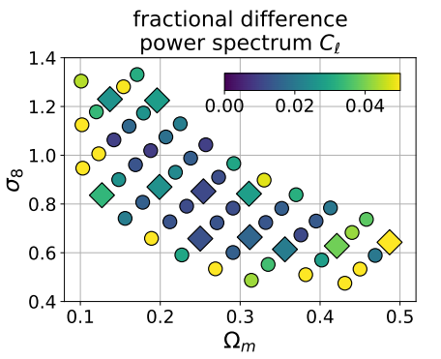
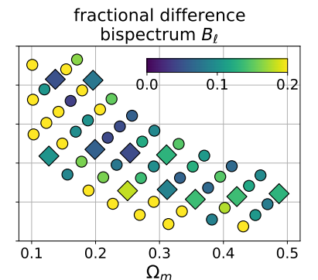
Reconstruct the Mass Map
N-body + Ray-tracing:
● expensive and slow
GAN-based generative models:
● field-level, fast and cheap
● the accuracy is insufficient
unstable in challenging regimes
low training efficiency
Residual Label-conditional flow matching generative network:
● support interpolation
● improved algorithm: operates in a residual space with data-driven flows
● very fast, higher overall statistical accuracy
emulators using GAN
(Perraudin, 2021, arXiv:2004.08139)

Slide 3
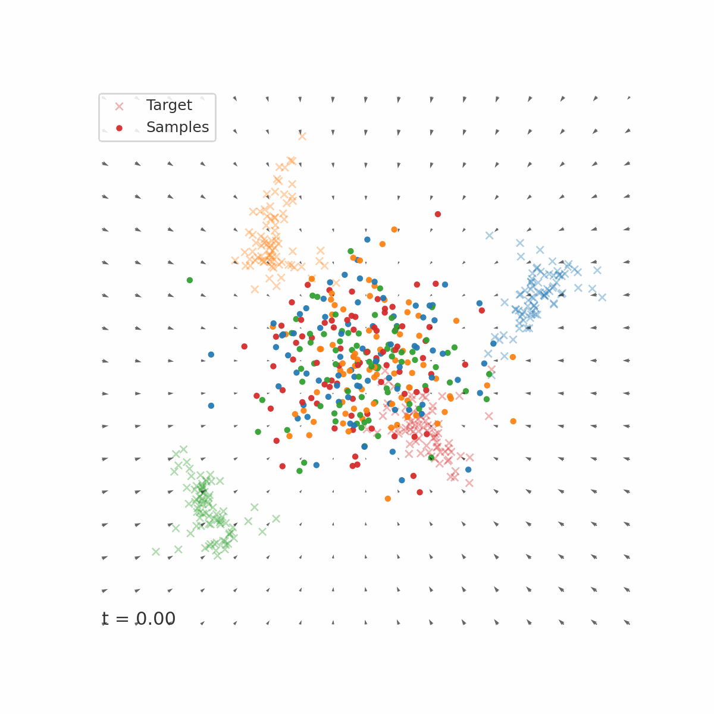

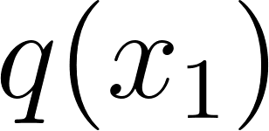
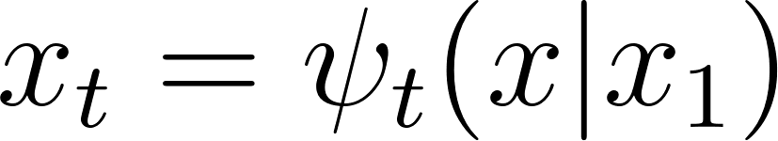
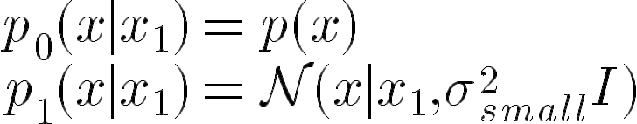
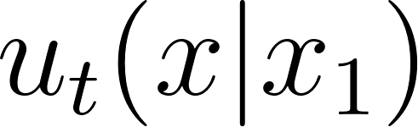
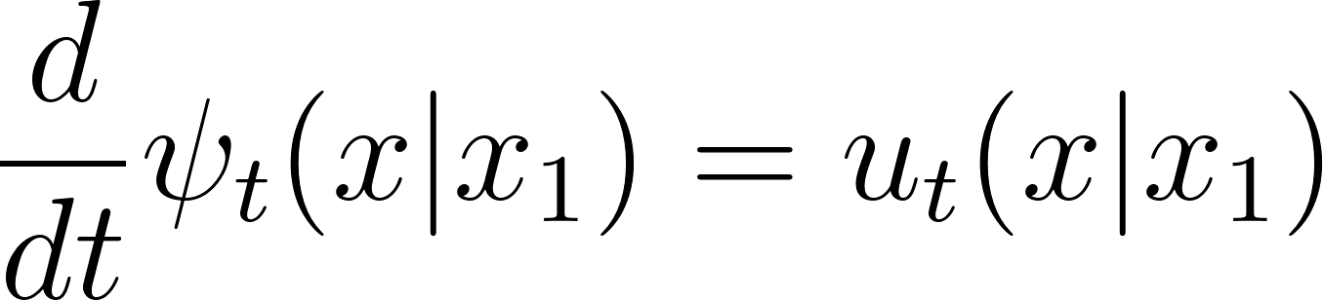
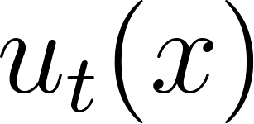
Conditional Flow Matching (CFM, Lipman et al., 2022, arXiv:2210.02747)
● Observed: data samples from unknown distribution
⇒ a conditional flow with boundary conditions:
● conditional velocity field :
the CFM objective is:
●
⇒ minimize CFM objective ⇒ target marginal velocity field
Flow Matching: simulation-free CNF training by regressing time-dependent vector fields

Slide 4
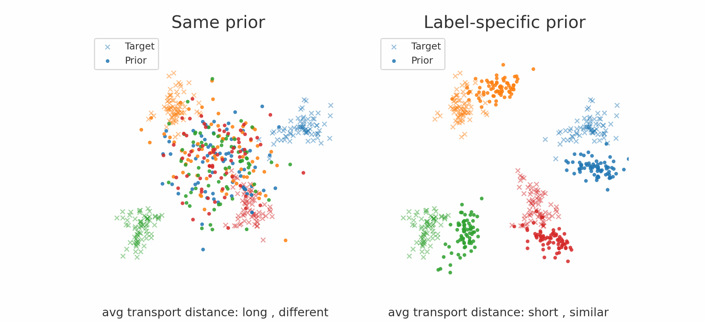
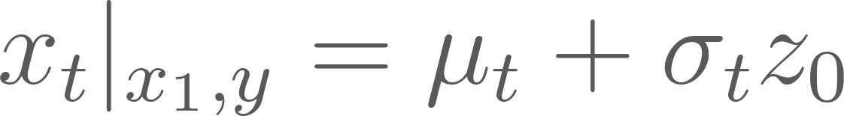
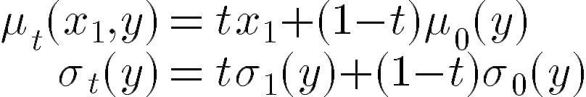
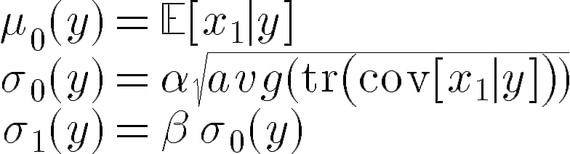
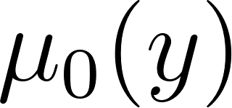
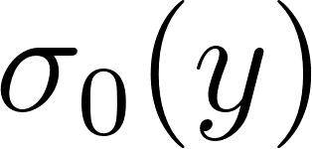
Residual Label-conditional Flow Matching (RLCFM)
label-specific flow:
where
label-specific Gaussian prior:
where
● : Gaussian Process Regressor (GPR)
● : Low-order Polynomial Ridge
Predictor:
Uniform source prior N(x|0, I) label-specific source priors

Slide 5
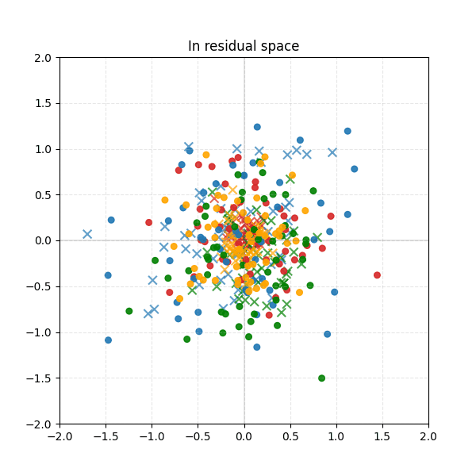
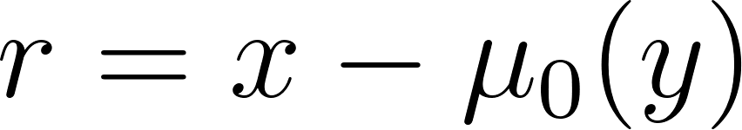
Improving Interpolation Statistics
we introduce a residual space:
per-label mean subtraction
prior in residual space:
full RLCFM objective:

Slide 6
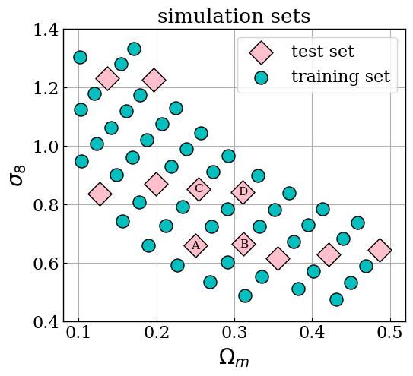

Dataset
57 N-body simulations (KiDS-450 like)
non-tomographic cosmologies within
without noise and intrinsic alignments
two parameter: Ωm and σ8;
each 12,000 maps;
(1,128,128), 5 deg × 5 deg

Slide 7
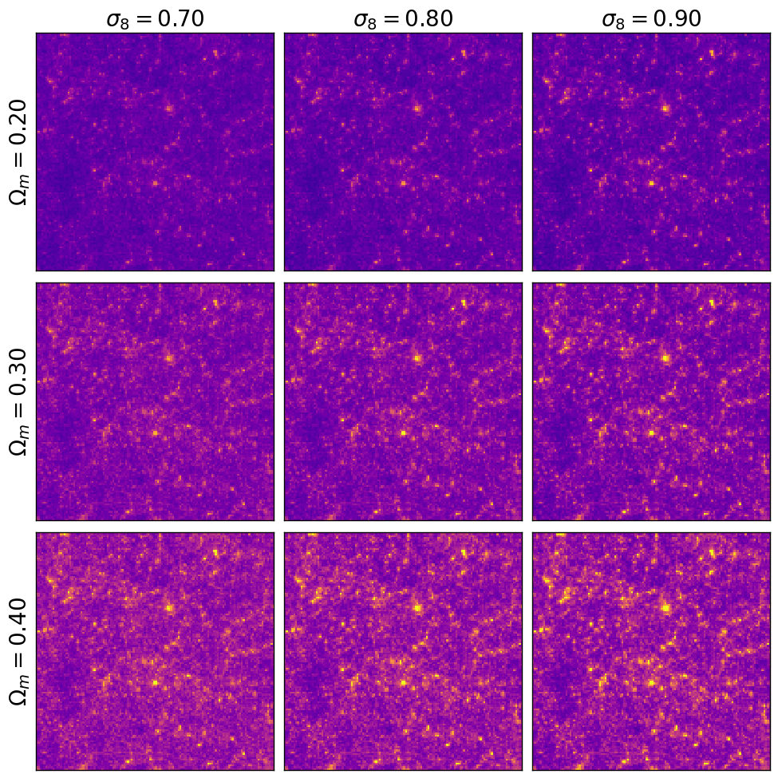
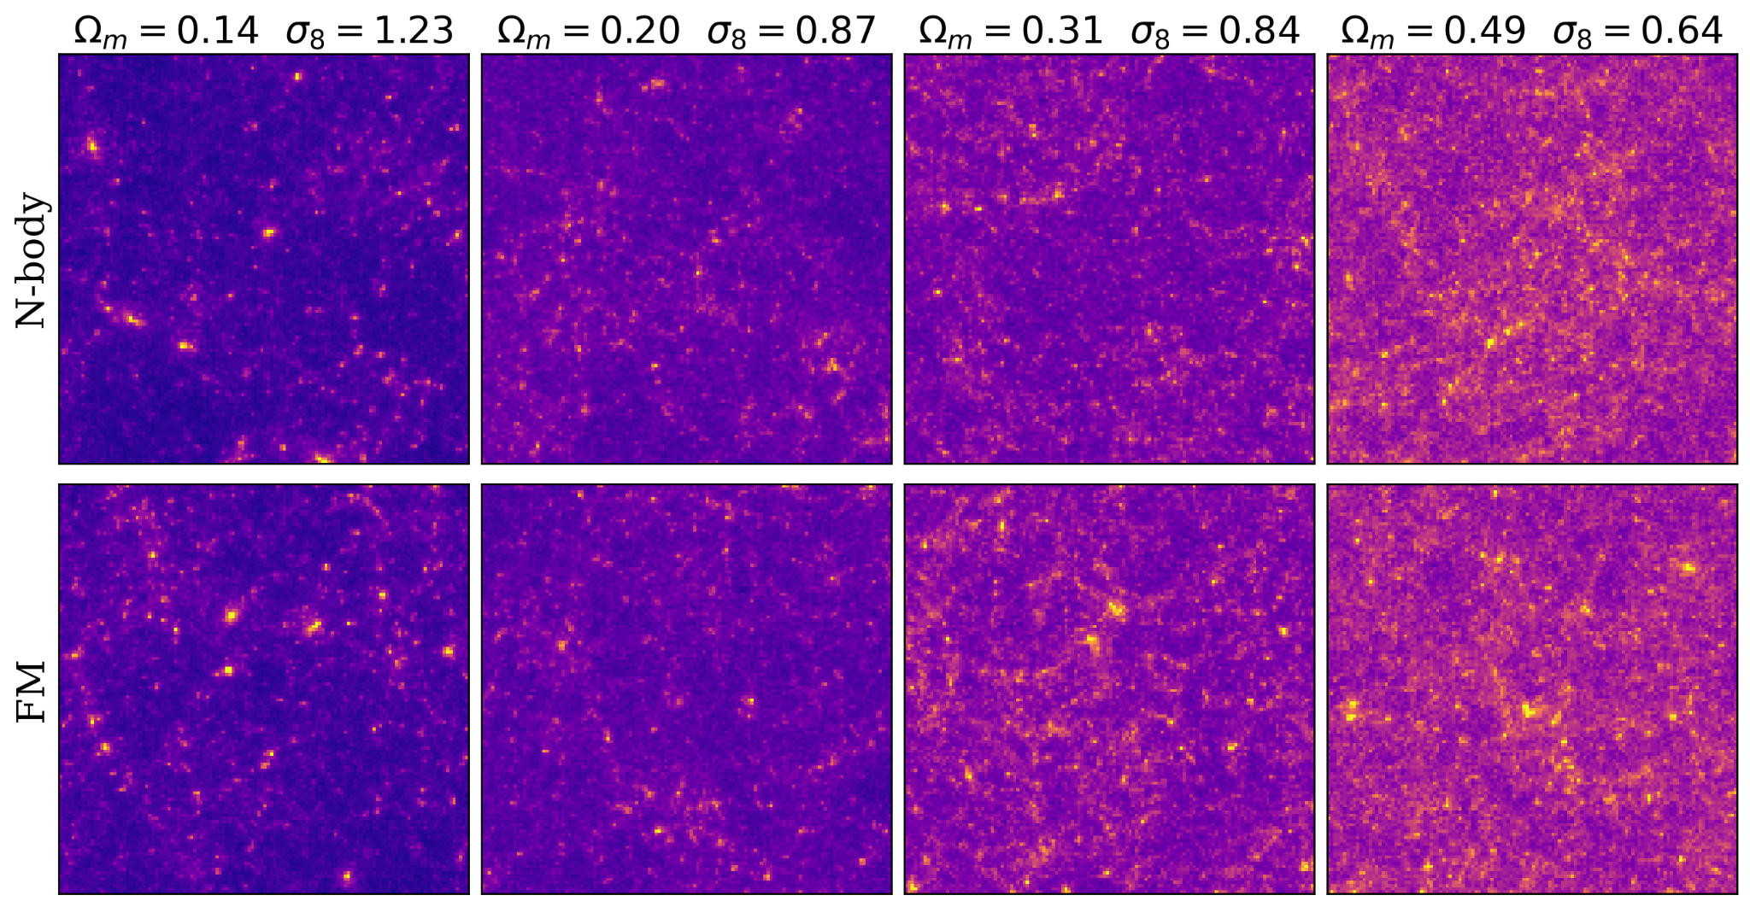
Result
Ωm ↑ → more mass in convergence maps
σ8 ↑ → higher pixel-intensity variance
contrast of the image is more obvious.
images for four cosmological parameter sets
Images generated from the same initial noise

Slide 8
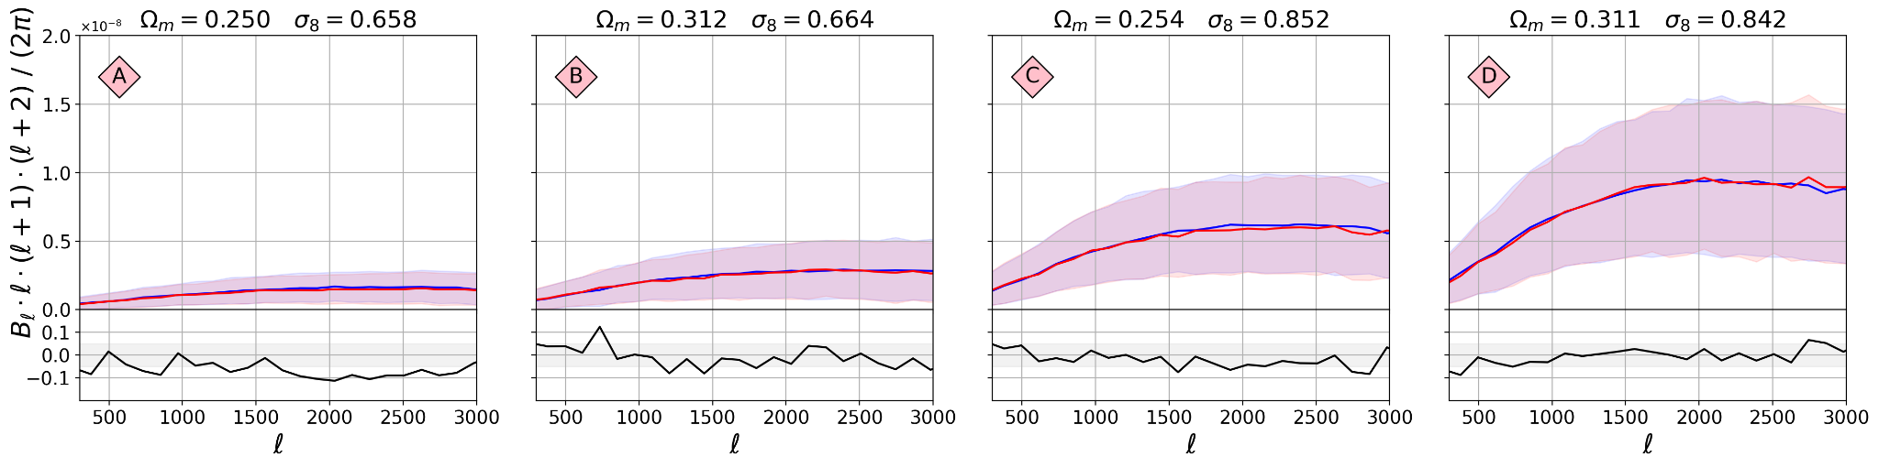
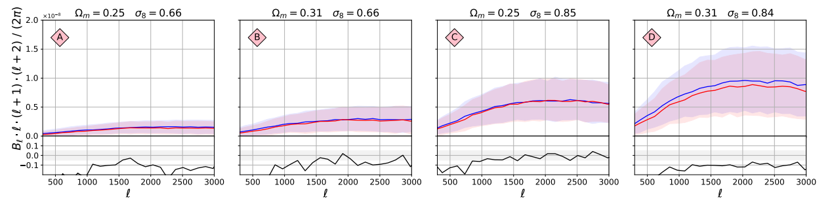
Bispectra
RLCFM
GAN
Perraudin

Slide 9
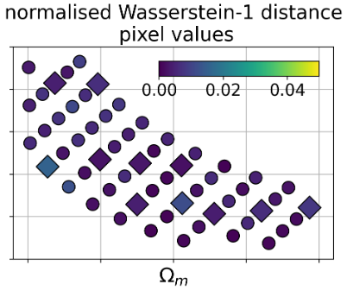
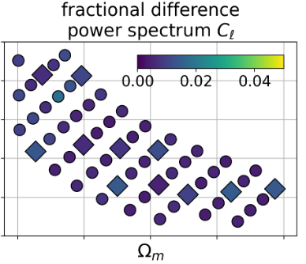
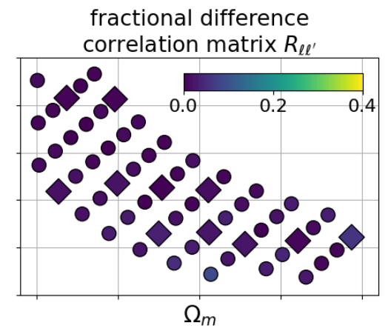
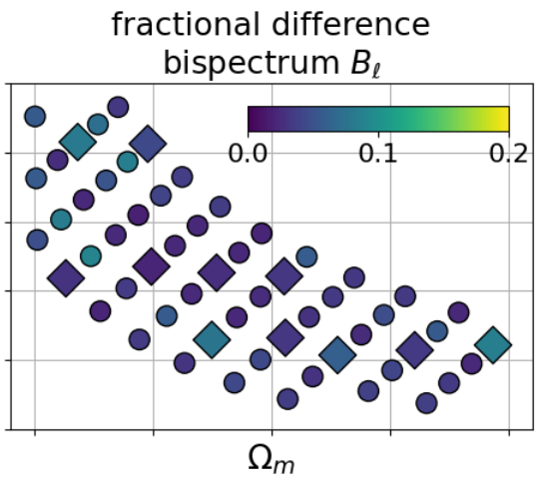
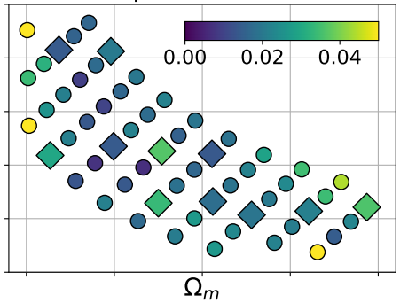
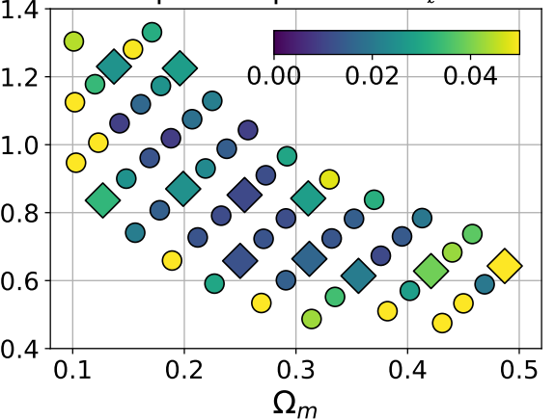
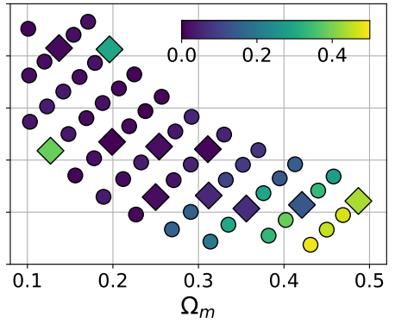
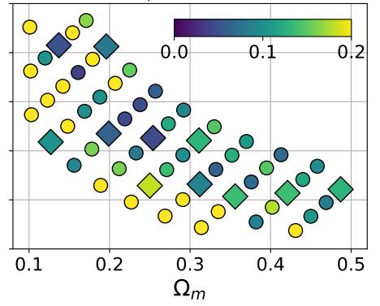
Overall Summary Statistics
~0.5%
~0.7%
~1.7%
~4%
RLCFM
15 epochs
GAN
40 epochs
(Perraudin)
higher statistical accuracy, more stable at the boundaries

Slide 10
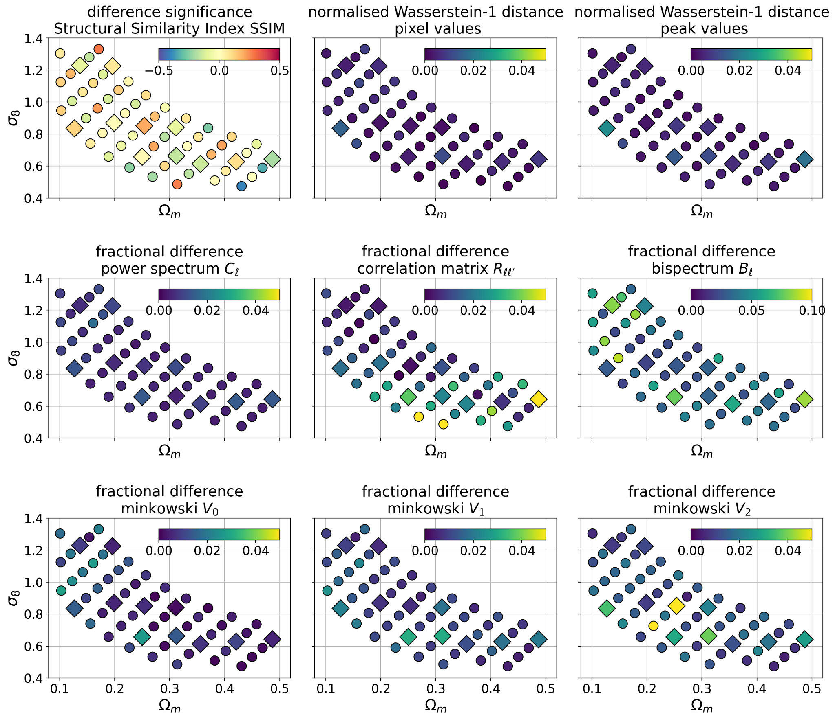
Detailed Results For RLCFM
~0.11
~0.13
~0.6%
~0.4%
~1.0%
~0.4%
~1.1%
~0.6%
~1.9%
~1.6%
~4.7%
~3.9%
~1.0%
~0.8%
~1.7%
~1.1%
~2.5%
~1.4%
better agreement !

Slide 11
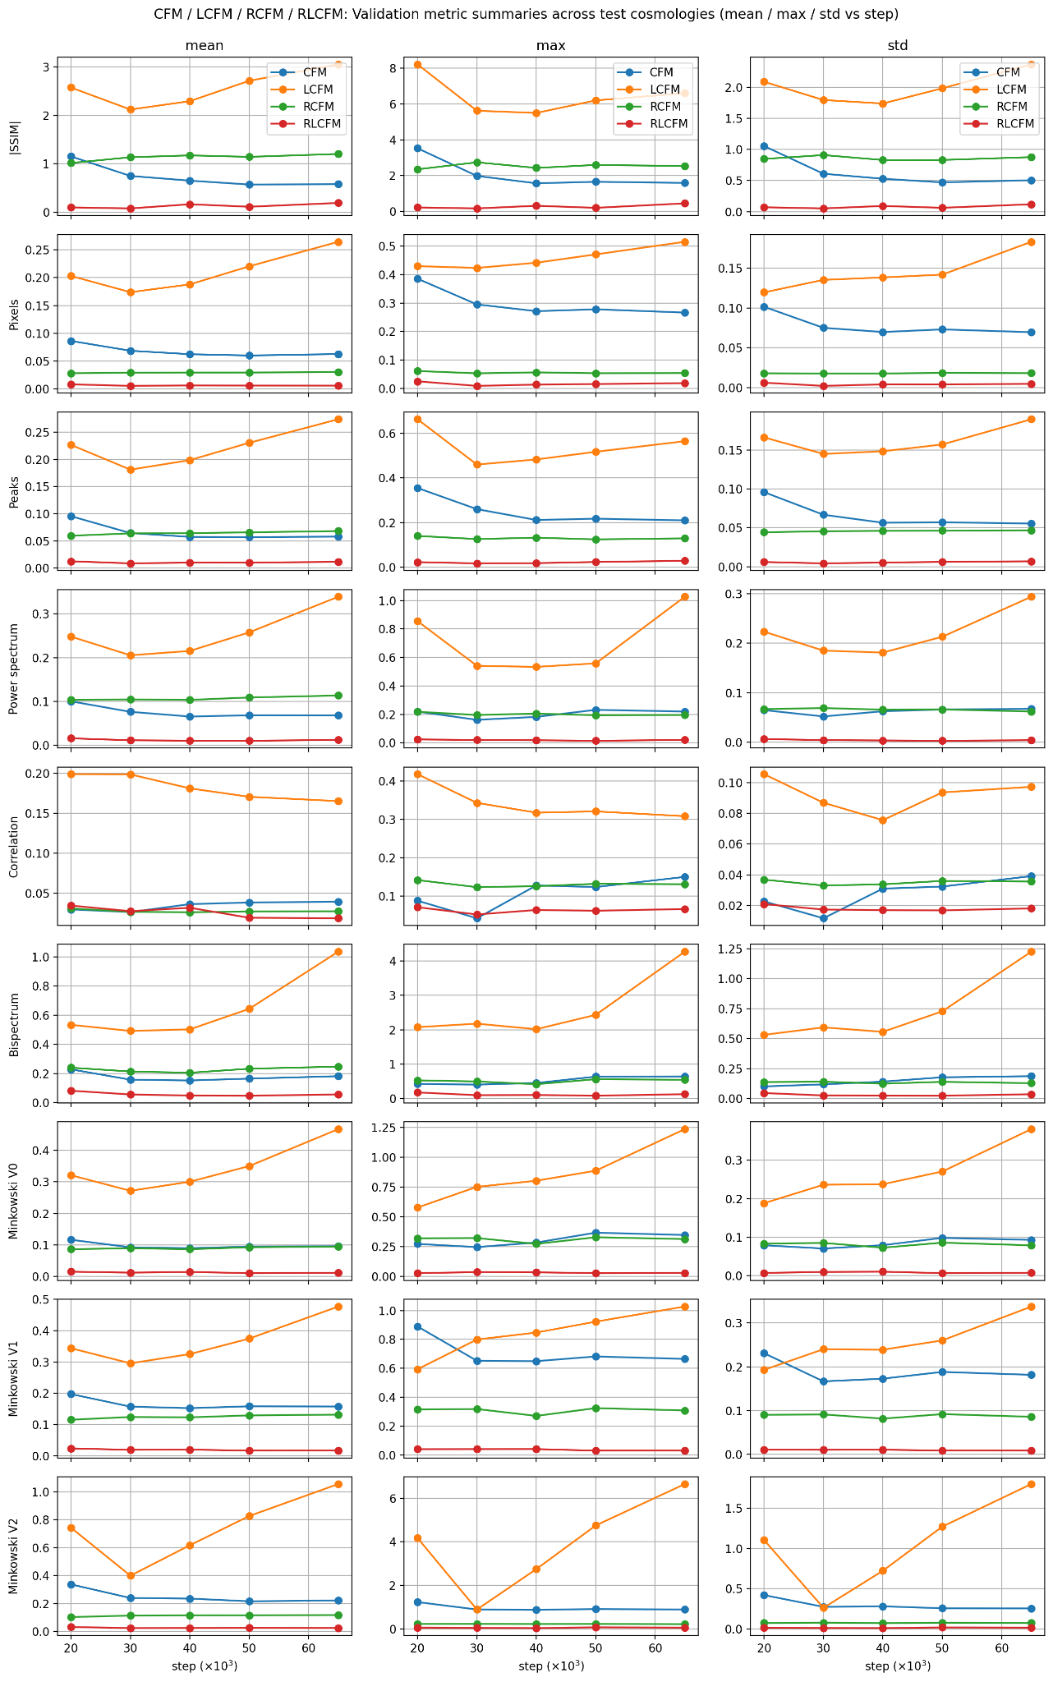
Ablation study on 11 test parameter points
(interpolation point)
CFM(Baseline): standard CFM
LCFM: label-specific prior only
RCFM: residual space only
RLCFM: full, label-specific prior+residual space
residual space: remove the main label-dependent mean shifts
label-specific prior: bring the starting distribution closer to the target

Slide 12
Conclusion
RLCFM for cosmological mass map generation:
● data-driven prior and label-specific flow
● train in a residual space
● embed continuous labels into the U-NET
Performance：
● Interpolation
● higher accuracy and is more stable
● very fast; A100 for 9 hours, 15 epochs
Scalability: generative models with an appropriate physics-informed/data-driven prior
The contribution brings us closer to a practical mass map emulator！
design a predictor for
RLCFM task-specific neural networks high-quality scientific images

